Slide 1
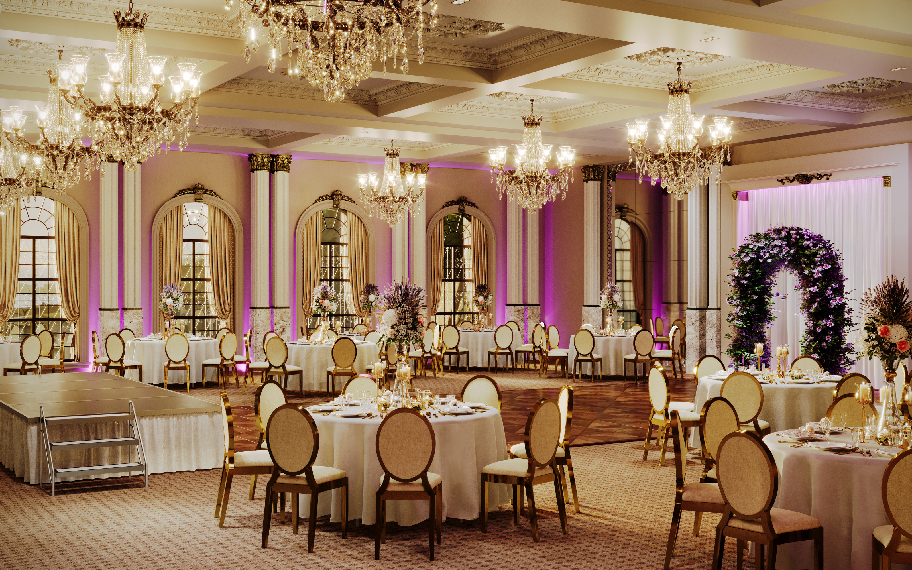
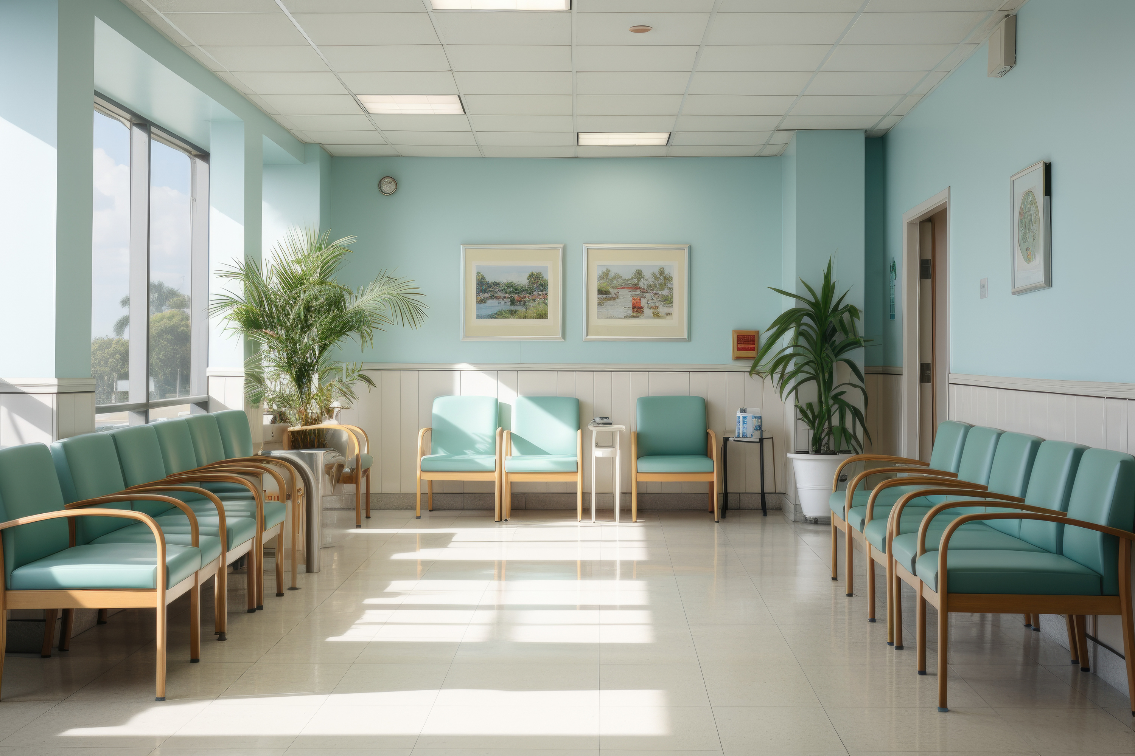
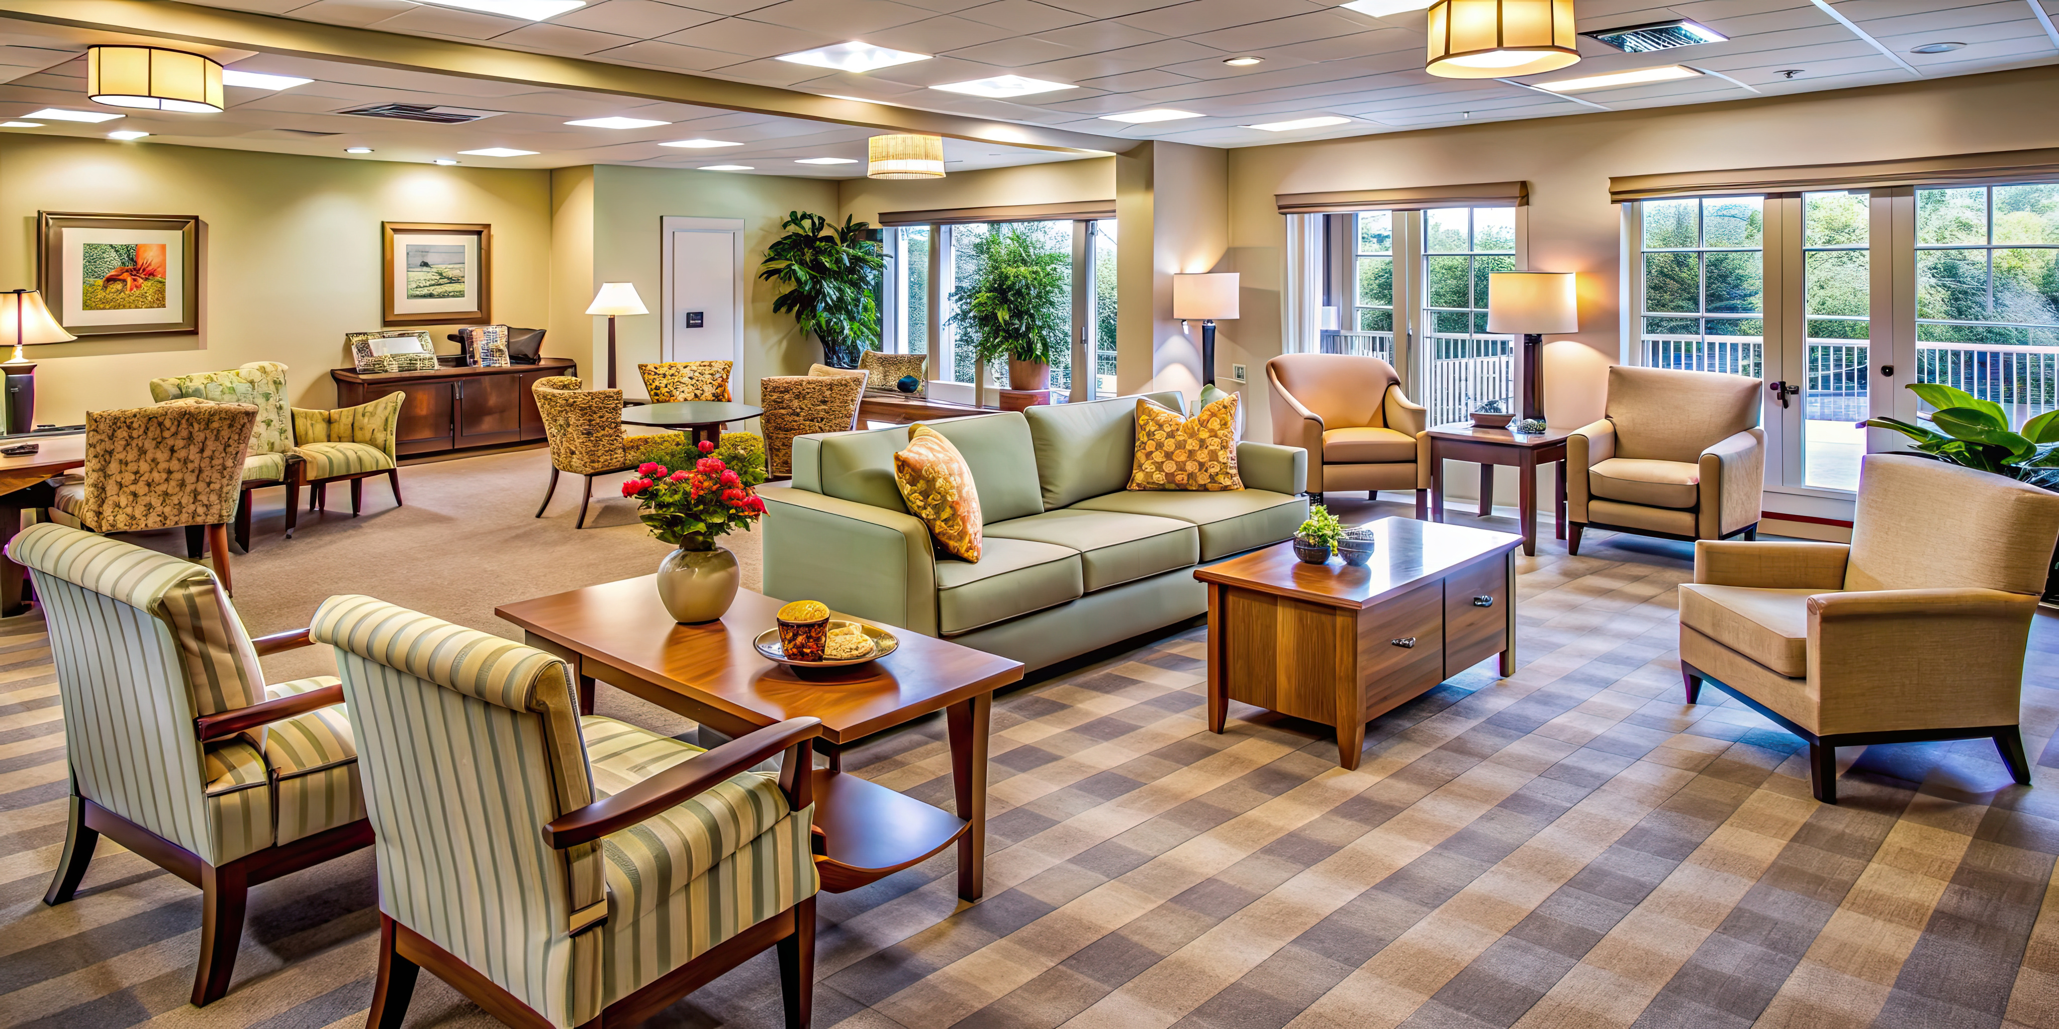

Healthcare & Senior Living
www.auraseating.com sales@auraseating.com
310-373-0129
2785 Pacific Coast Hwy Ste E129 Torrance, CA 90505

Slide 2
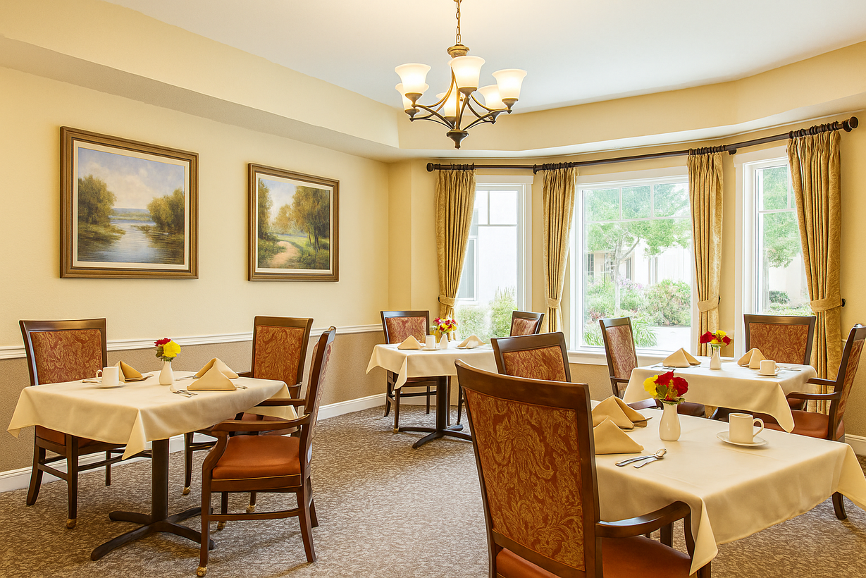
Why Aura?
Being a customer centric company, we believe in providing customizable solutions through product design, manufacturing, white glove-delivery, and installation.
We offer sustainable, durable, and cleanable products made from yoga for posture principles to help with your health and well-being.
Made in the USA located in California & Wisconsin.
We specialize in manufacturing made-to-order custom products in contract, hospitality, healthcare and senior living.

Slide 3


Our Passion
Building Relationships
Sustainability
We believe in building long-lasting relationships with our customers and partners by walking in their shoes at every level of our business from sales to delivery.
We strive to be a part of your success story.
As a California Certified Green Business, we make every effort to reduce our environmental footprint. We believe we can save the planet by designing and building products with sustainable materials and manufacturing processes.
We love doing business with the planet in mind.

Slide 4
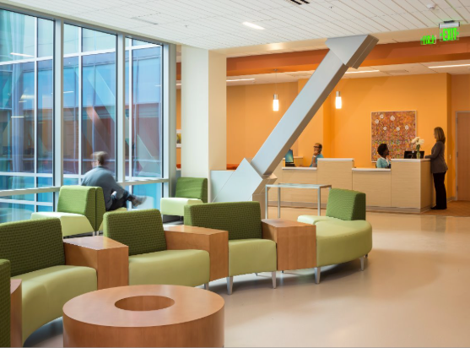
Our Capabilities
Customer Unique Product Designs Based on Customer Requirements
12 Year Structural Frame Warranty
Designed and Made in the USA
Use of Ergonomics, Yoga, Sustainability, and Cleanability in Product Design
White Glove Delivery Service & Installation
Excellent Customer Service and Communication

Slide 5
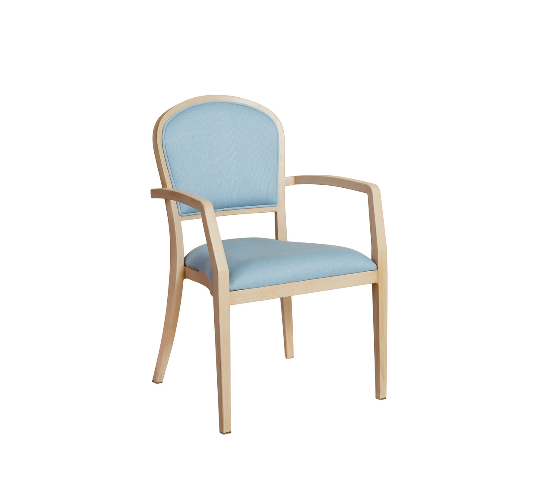
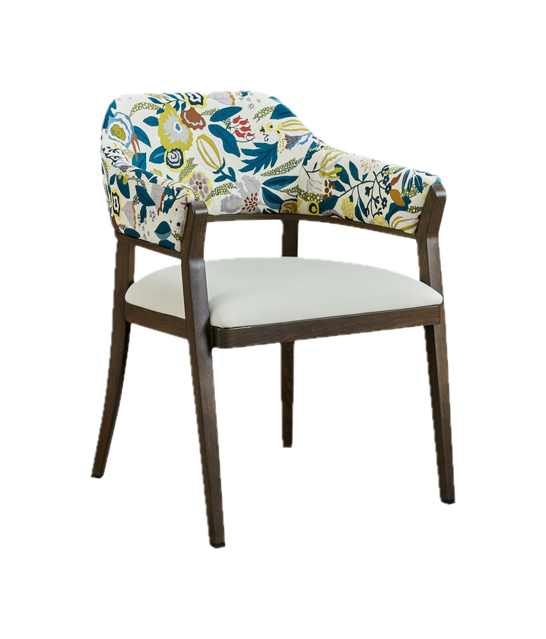
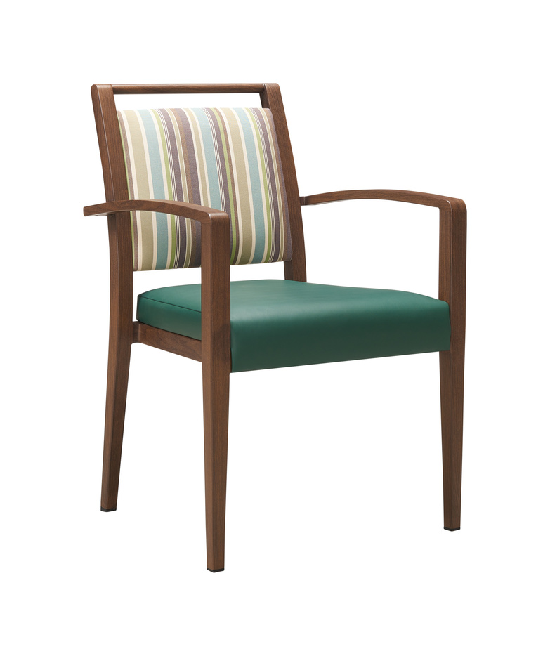
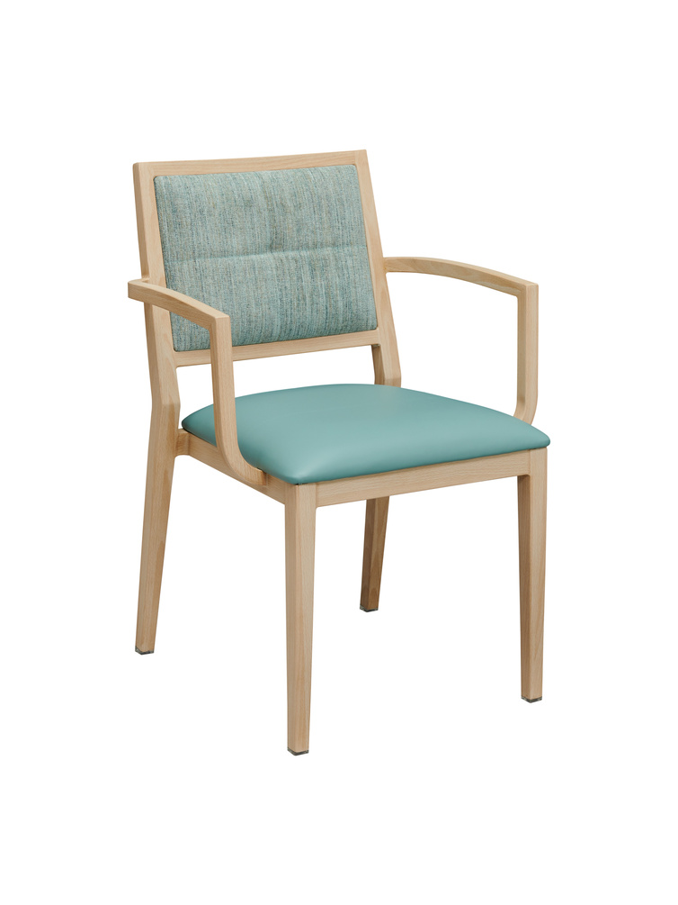
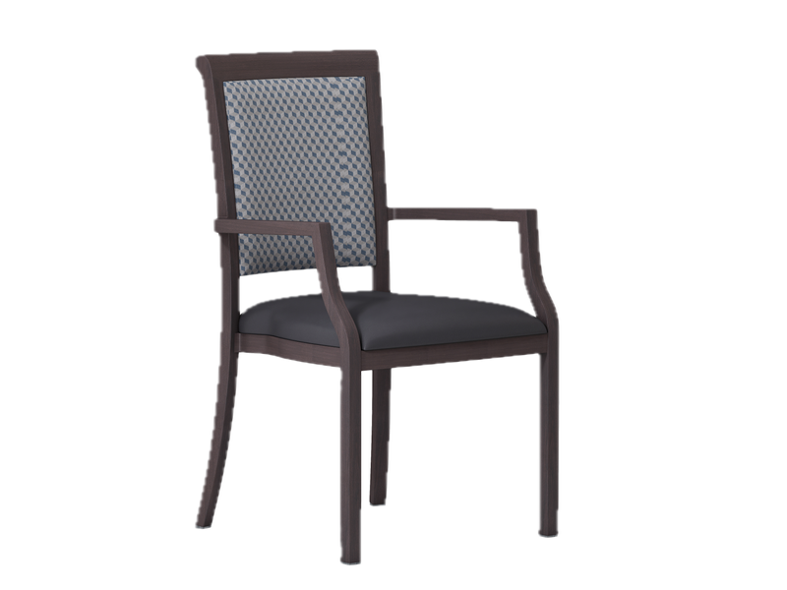
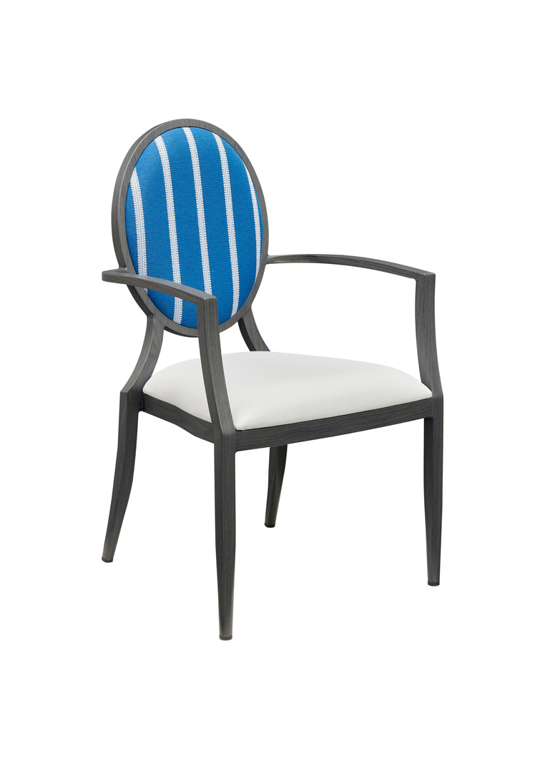
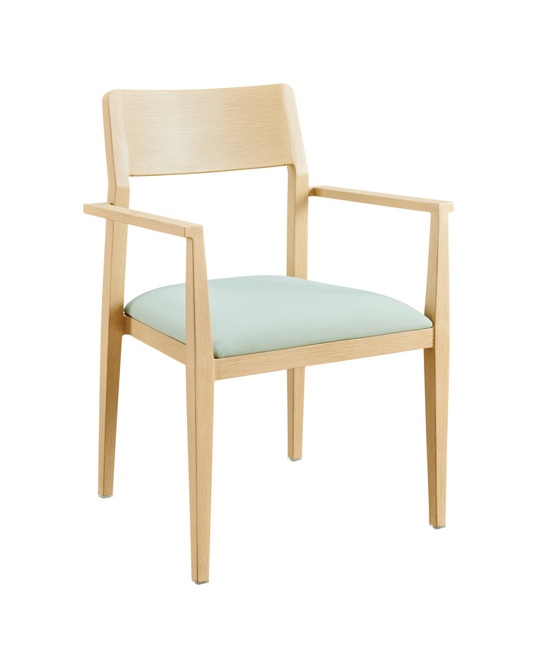
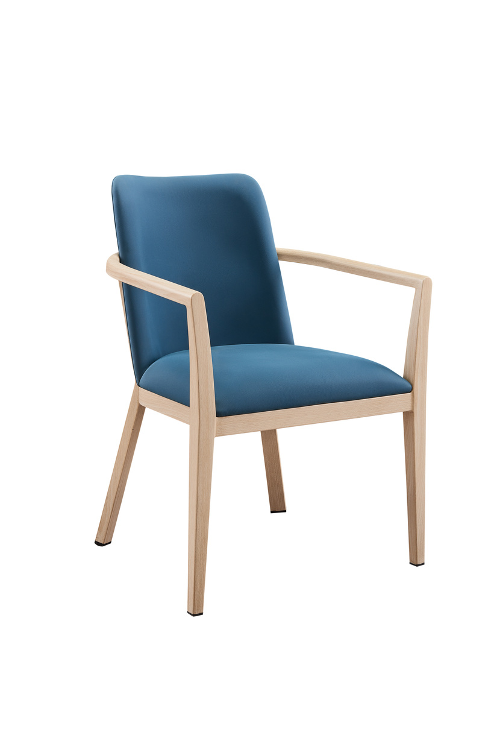
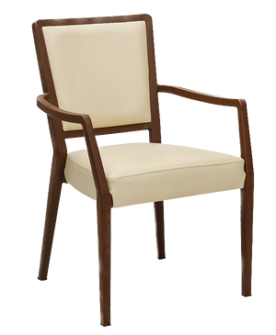
Our Products: Dining Chairs*
*For more chairs, please visit our website. For custom orders or more information please contact us at sales@auraseating.com

Slide 6
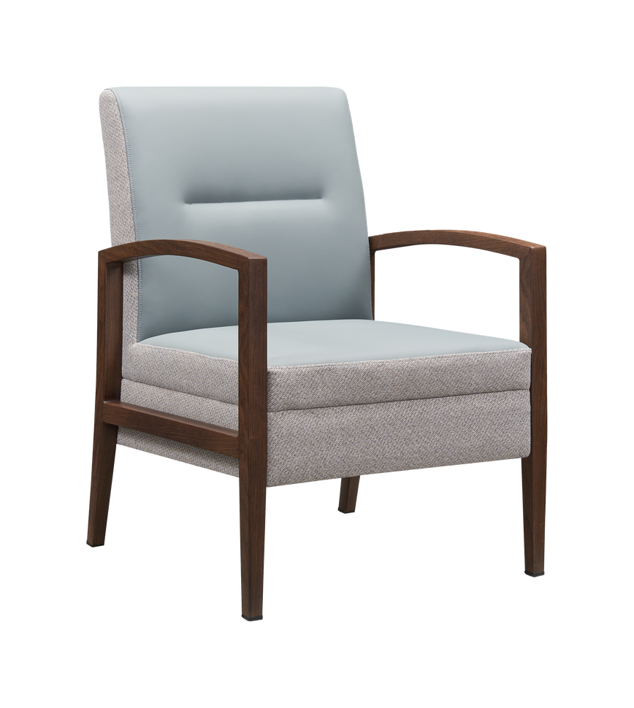
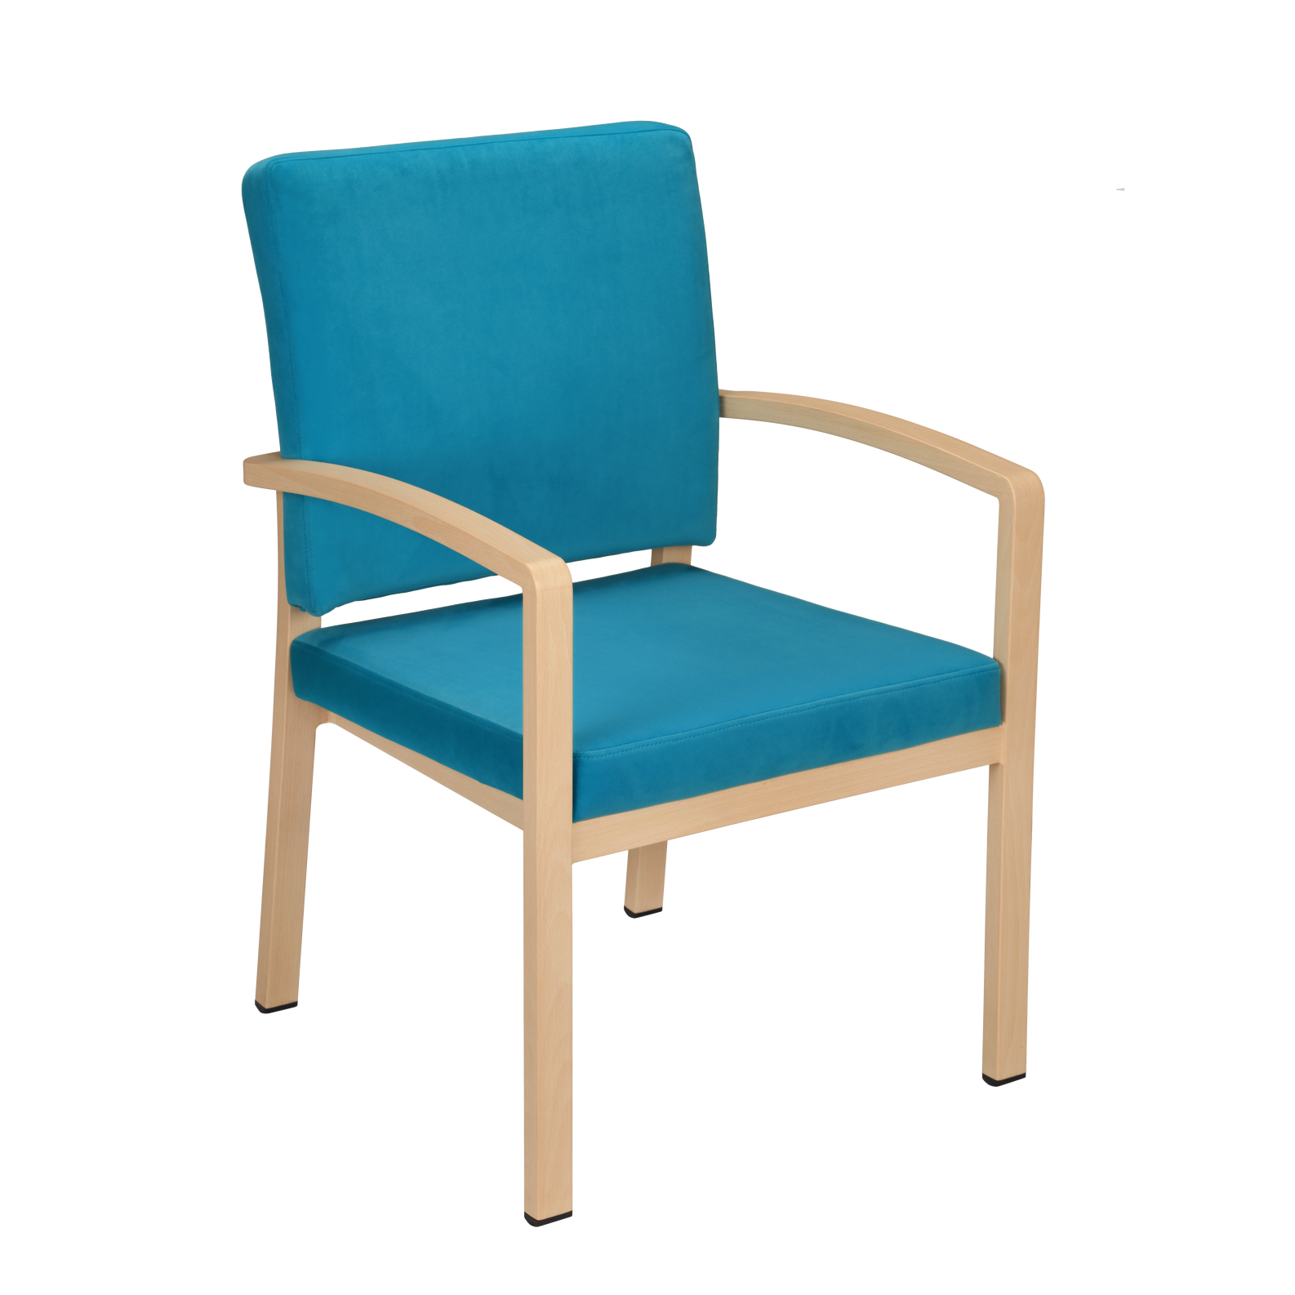
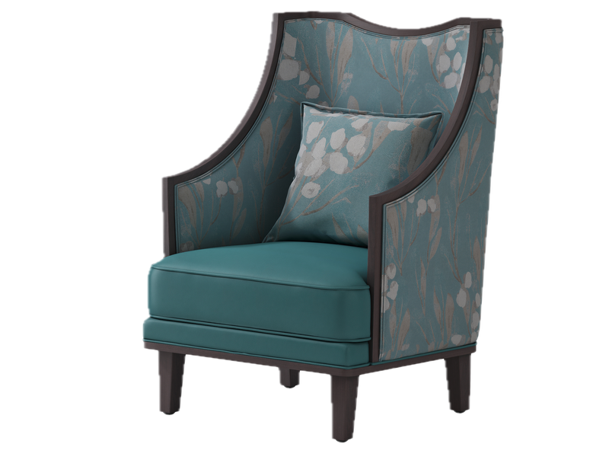
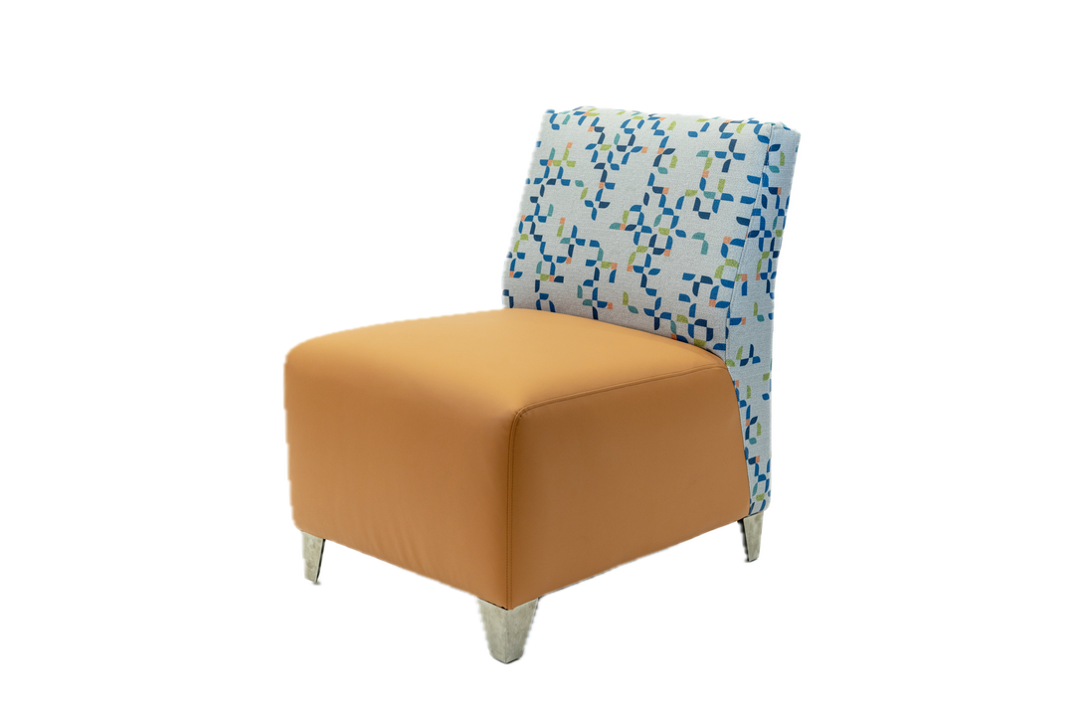
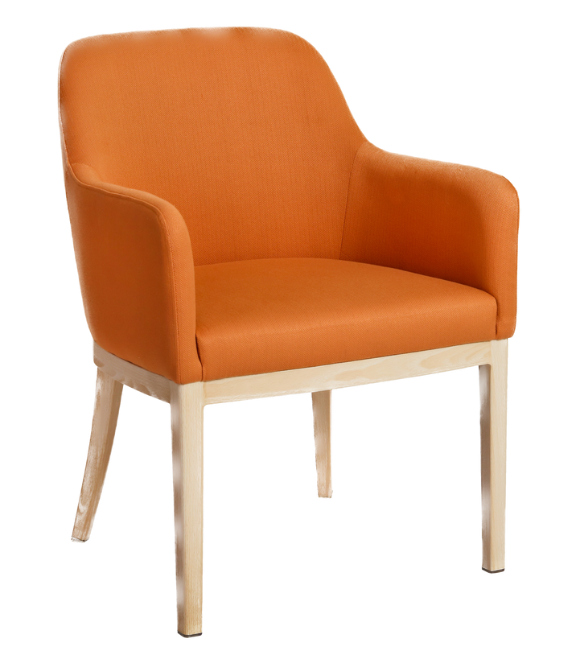
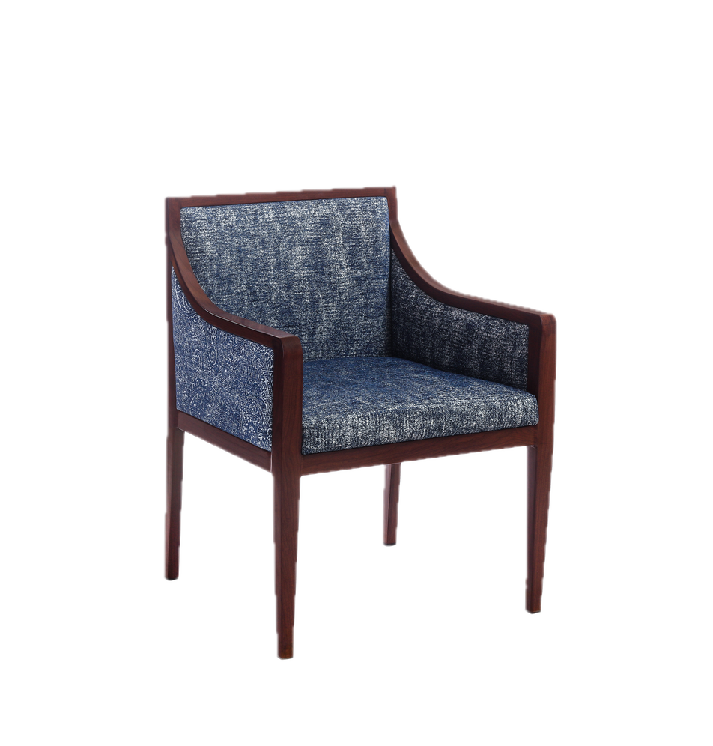
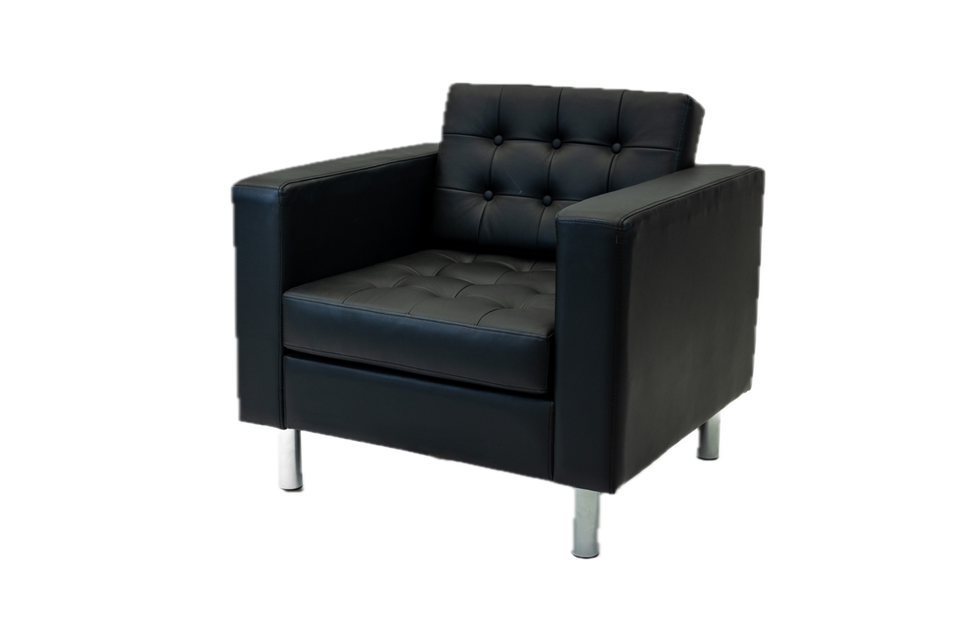
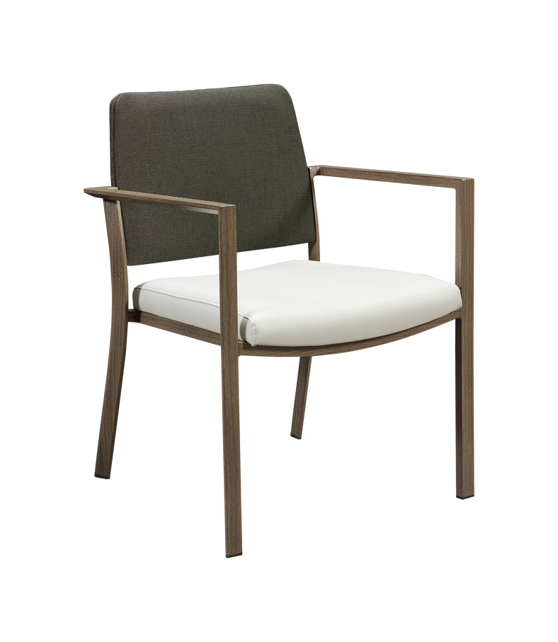
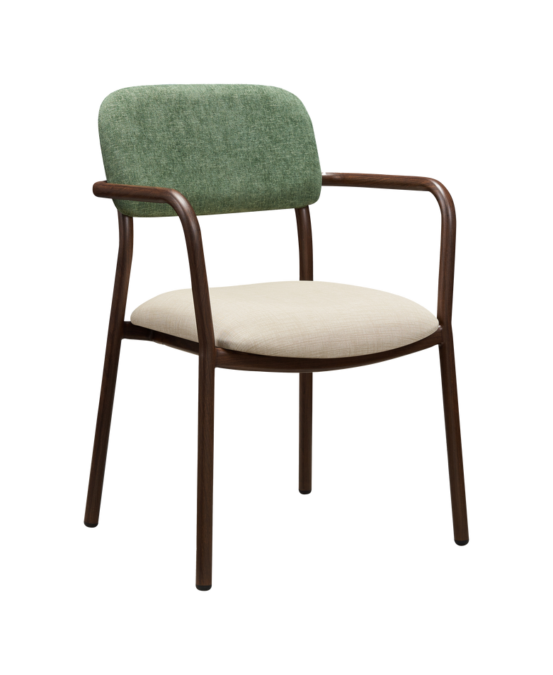
Our Products: Lounge & Waiting Room Chairs*
*For more chairs, please visit our website. For custom orders or more information please contact us at sales@auraseating.com

Slide 7
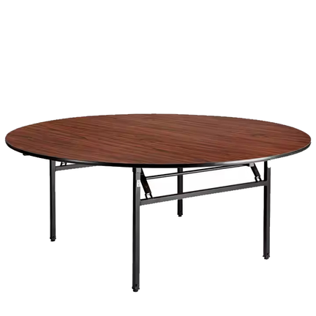
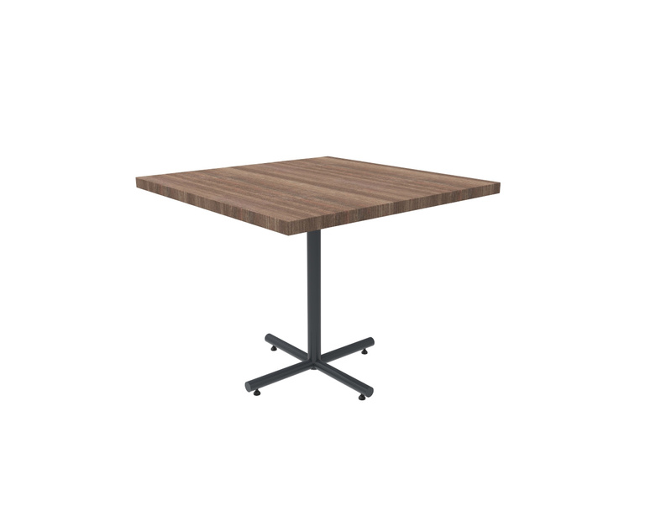
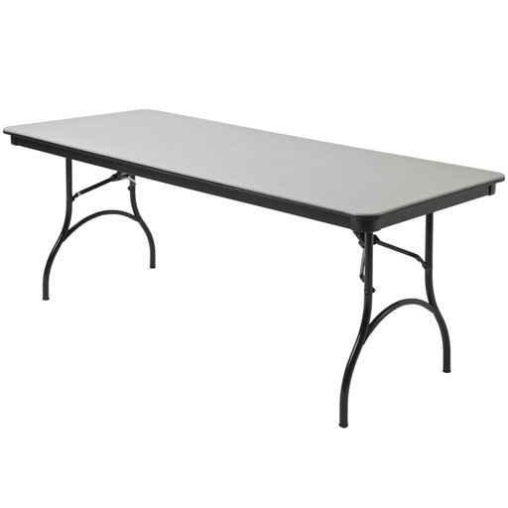
Our Products: Tables*
*For more tables, please visit our website. For custom orders or more information please contact us at sales@auraseating.com

Slide 8
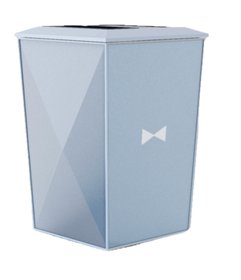
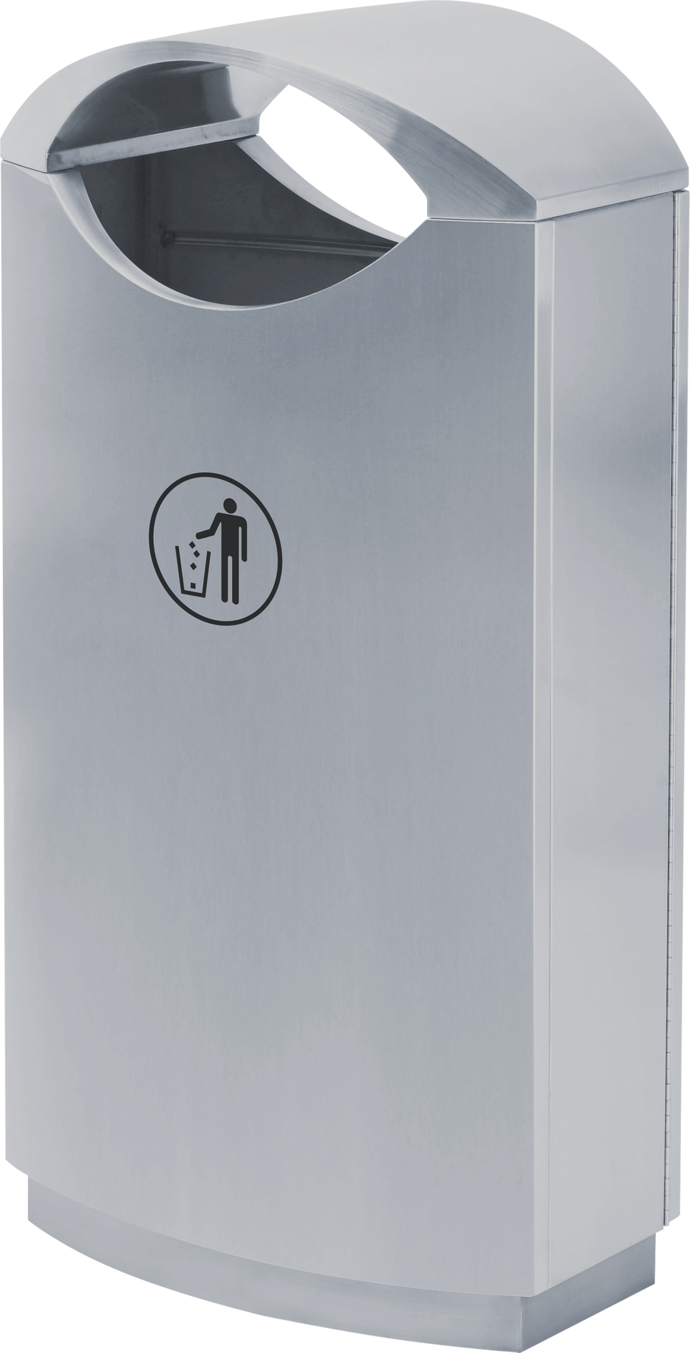
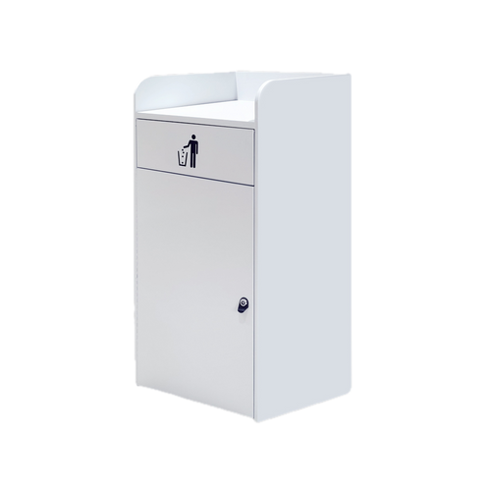
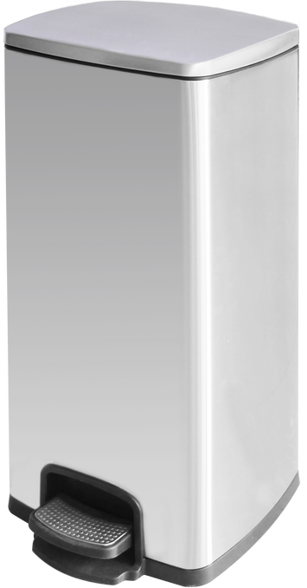
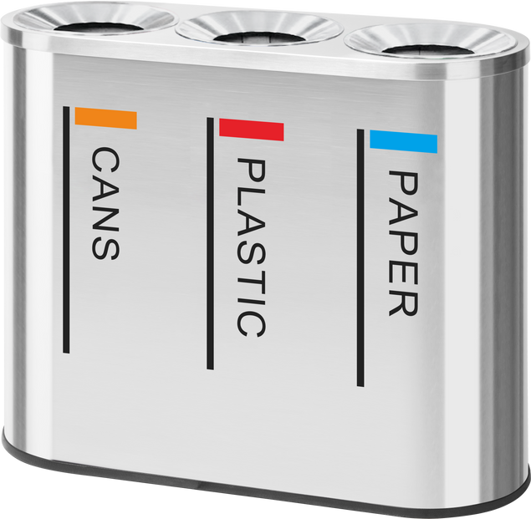
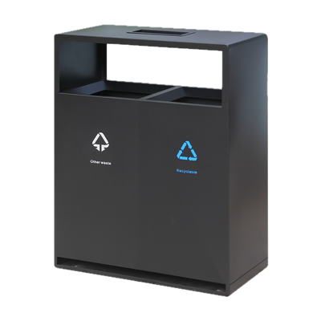
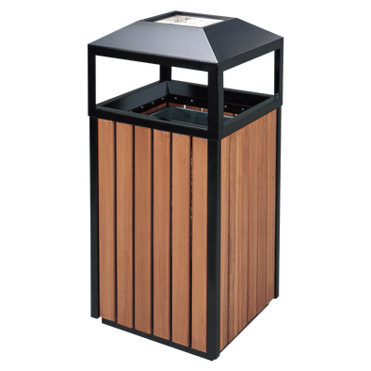
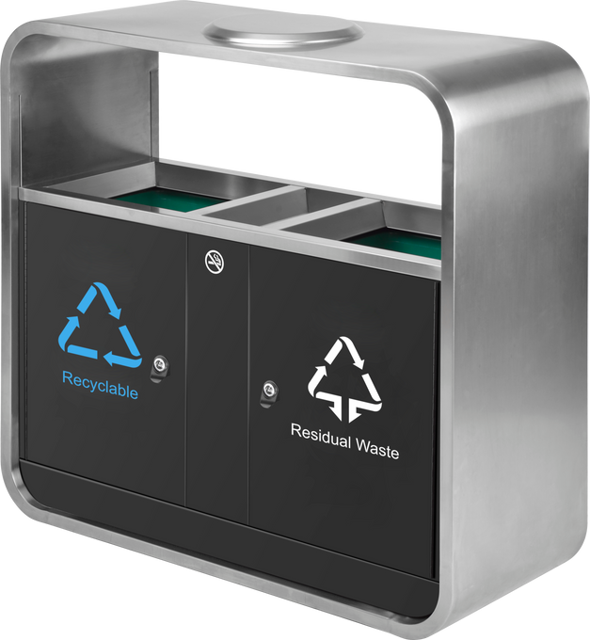
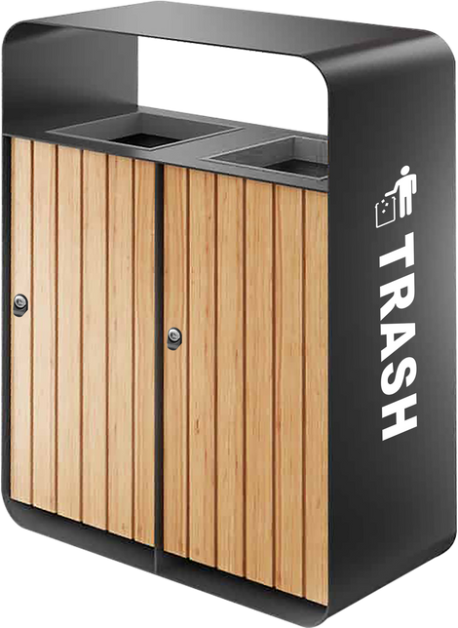
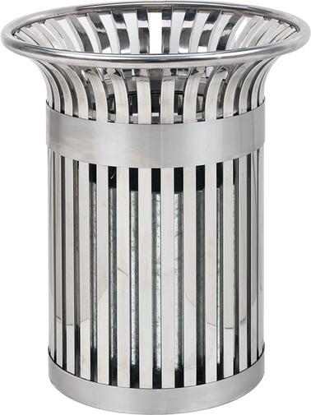
Our Products: Trash Cans*
*For more trash cans, please visit our website. For custom orders or more information please contact us at sales@auraseating.com

Slide 9
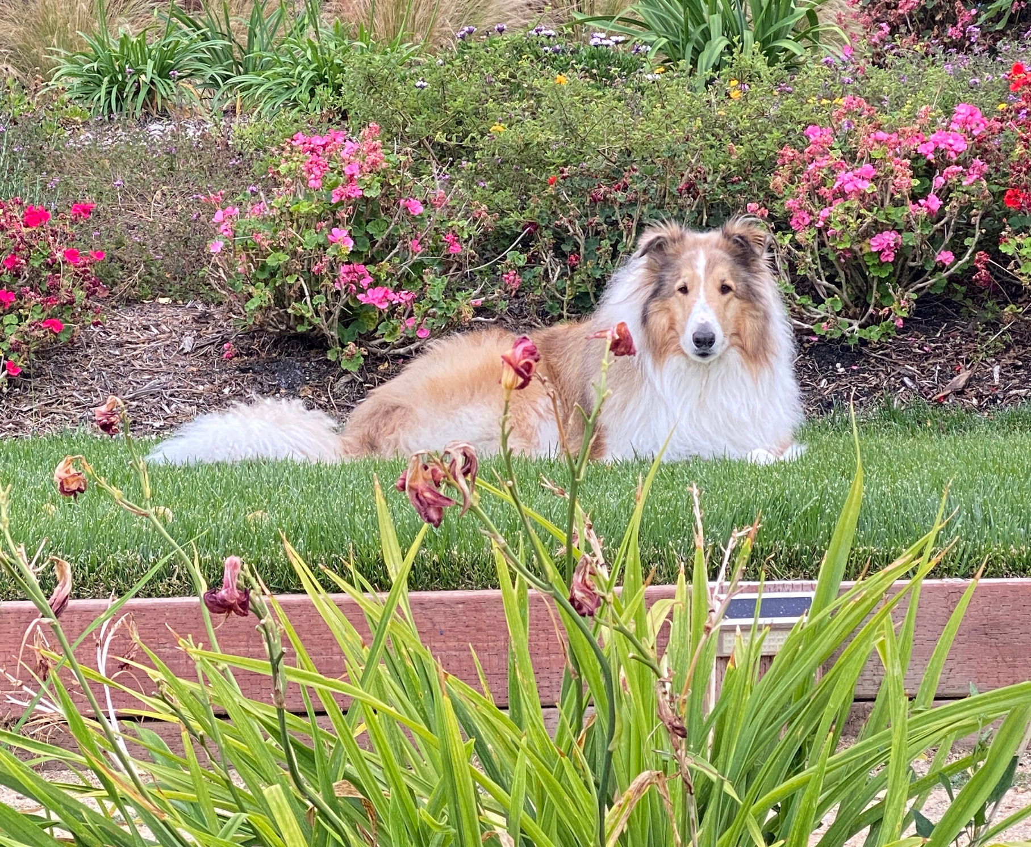

Please contact us for more information and custom products. We look forward to hearing from you!
Mahalo!
From the Aura Seating Team
Email: sales@auraseating.com
Phone: 310-373-0129
Website: auraseating.com
Office: 2785 Pacific Coast Hwy Ste E129, Torrance, CA 90505
Kanoa

