Slide 1
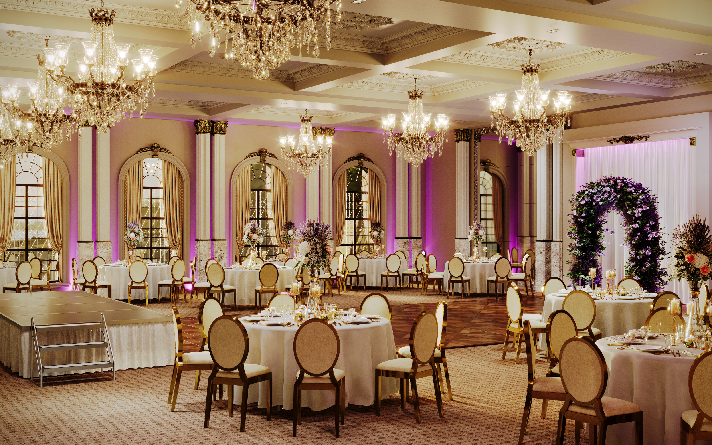

www.auraseating.com sales@auraseating.com
310-373-0129
22353 Western Ave Ste 202
Torrance, CA 90501
Hospitality

Slide 2
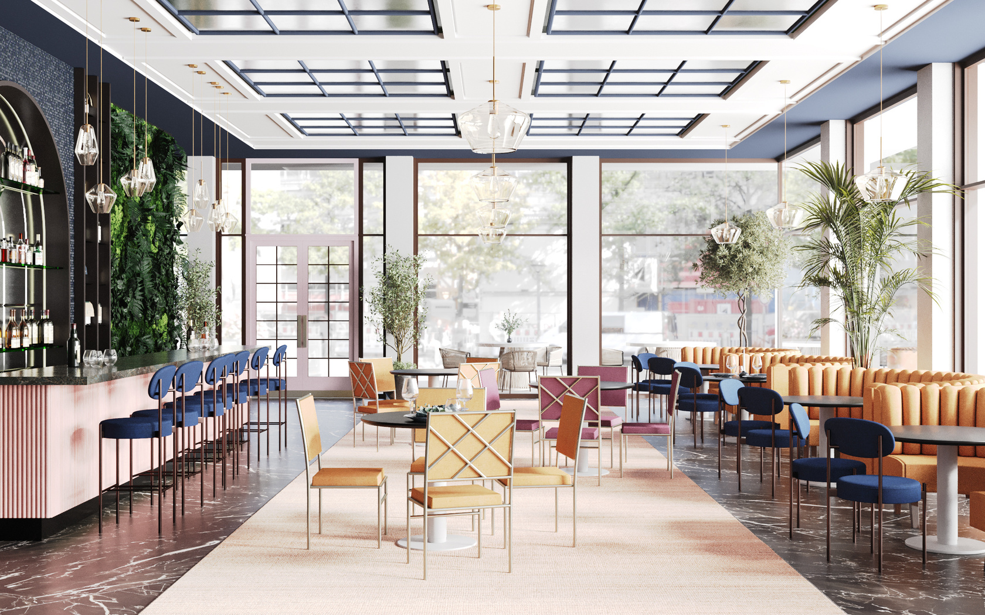
Why Aura?
Being a customer centric company, we believe in providing customizable solutions through product design, manufacturing, and white glove-delivery.
We offer sustainable and durable products made from yoga for posture principles to help with your health and well-being.
Made in the USA located in California & Wisconsin.
We specialize in manufacturing made-to-order custom products in contract, hospitality, healthcare and senior living.

Slide 3


Our Passion
Building Relationships
Sustainability
We believe in building long-lasting relationships with our customers and partners by walking in their shoes at every level of our business from sales to delivery.
We strive to be a part of your success story.
As a California Certified Green Business, we make every effort to reduce our environmental footprint. We believe we can save the planet by designing and building products with sustainable materials and manufacturing processes.
We love doing business with the planet in mind.

Slide 4
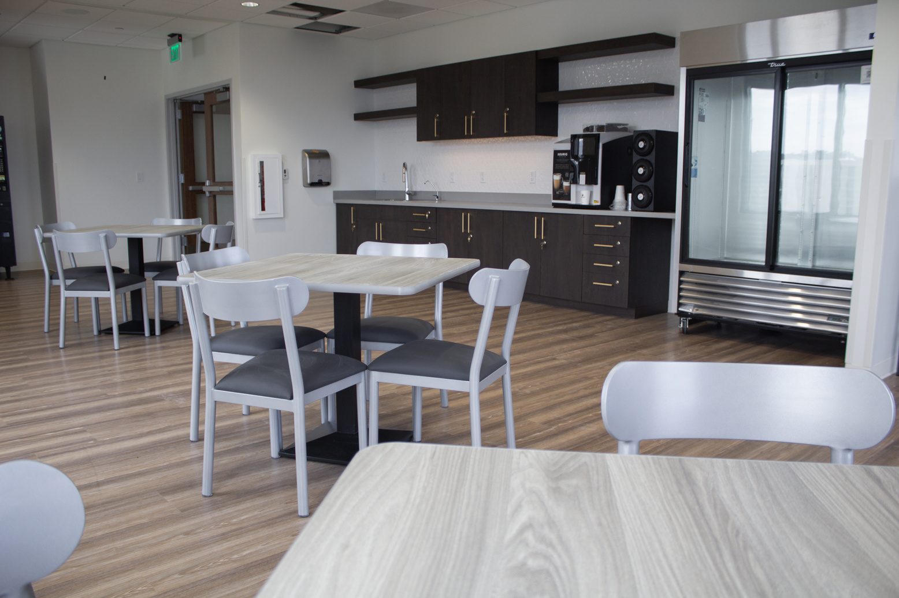
Our Capabilities
Customer Unique Product Designs with US Based Fabrics
Focus on Product End User & Ergonomics
12 Year Structural Frame Warranty
Designed and Made in the USA
Complete Line of Food Service Furniture
Customized Design to Meet Customer Requirements
White Glove Delivery Service & Installation
Excellent Customer Service and Communication

Slide 5












Our Customers

Slide 6
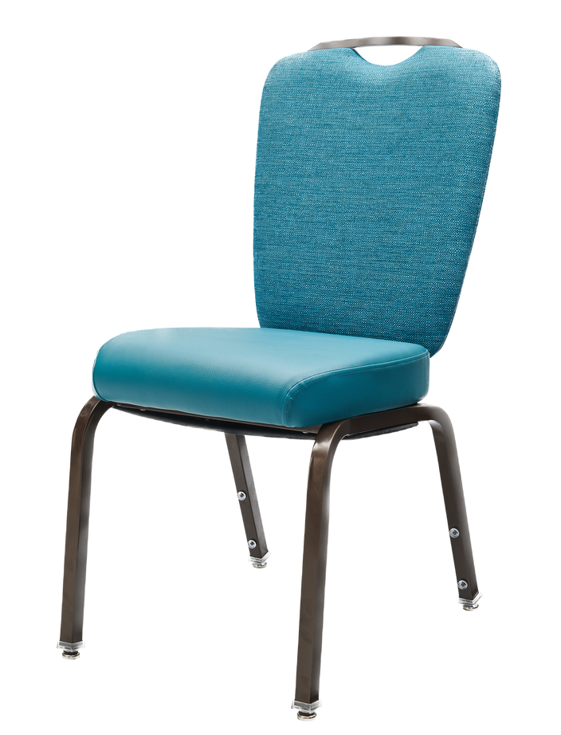
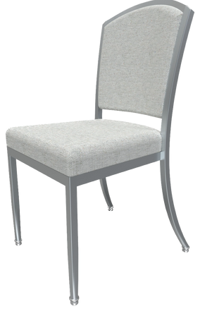
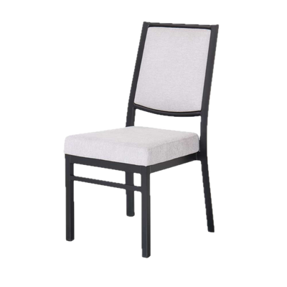
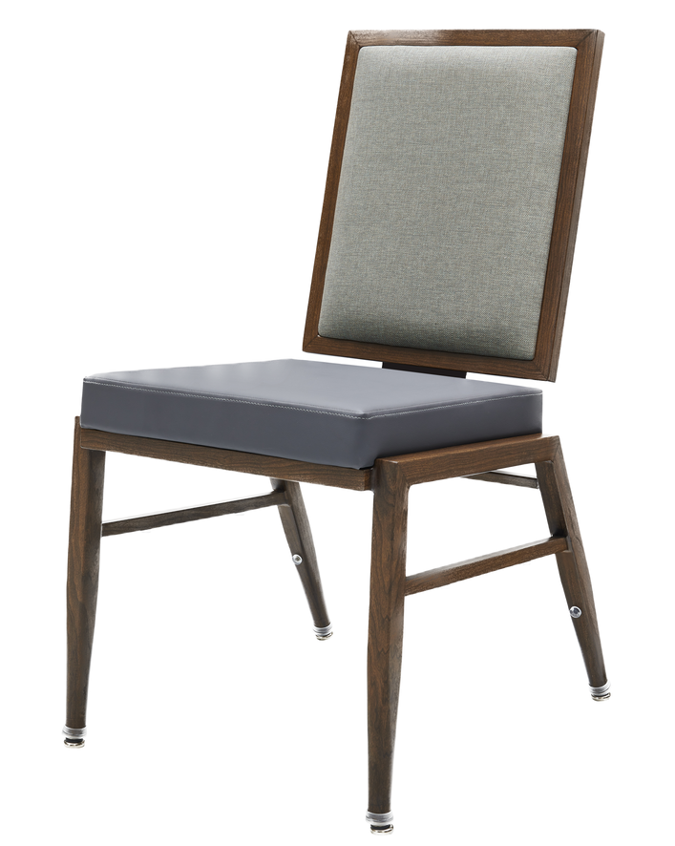
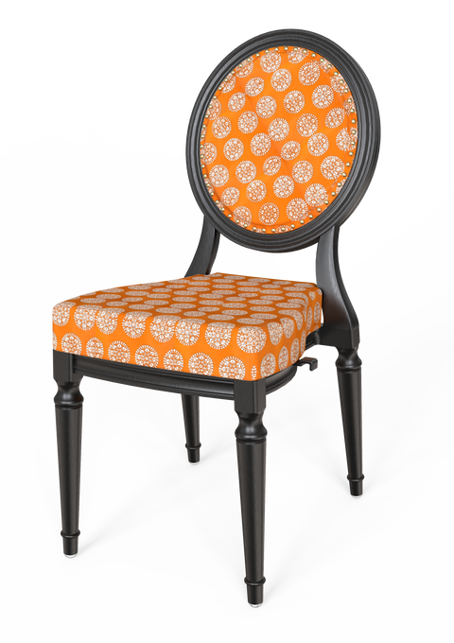
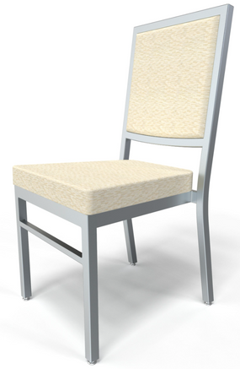
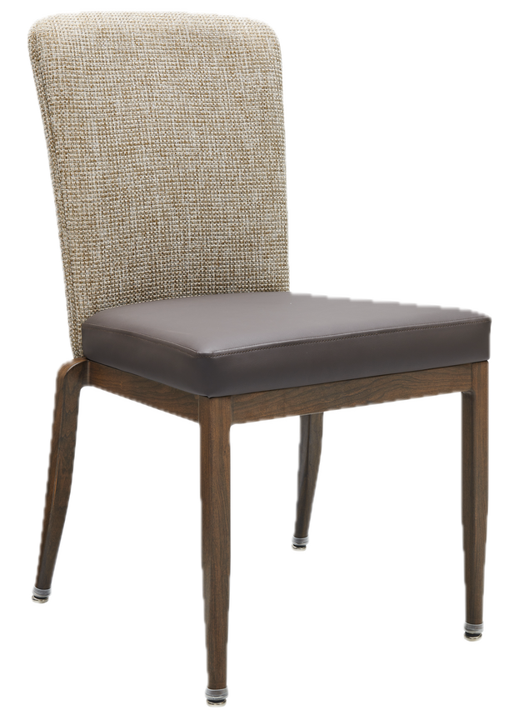
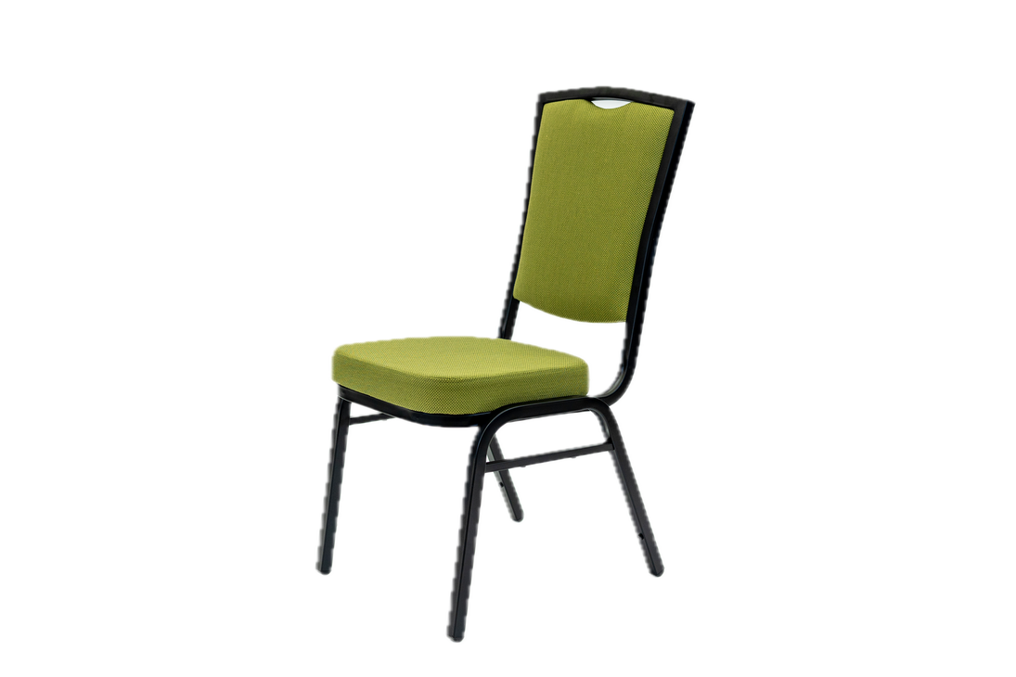
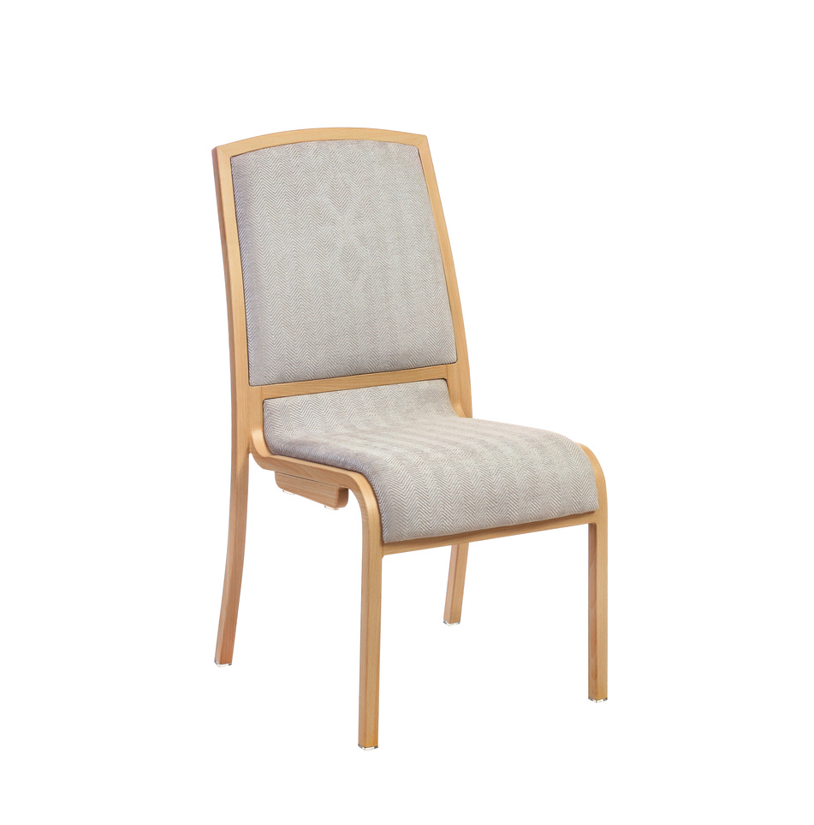
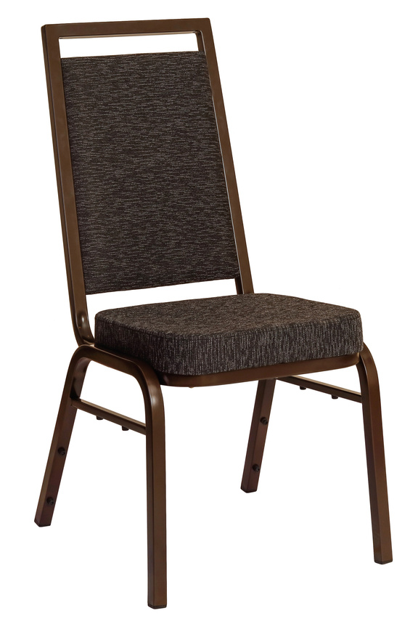
Our Products: Banquet Chairs*
*For more banquet chairs, please visit our website. For custom orders or more information please contact us at sales@auraseating.com

Slide 7
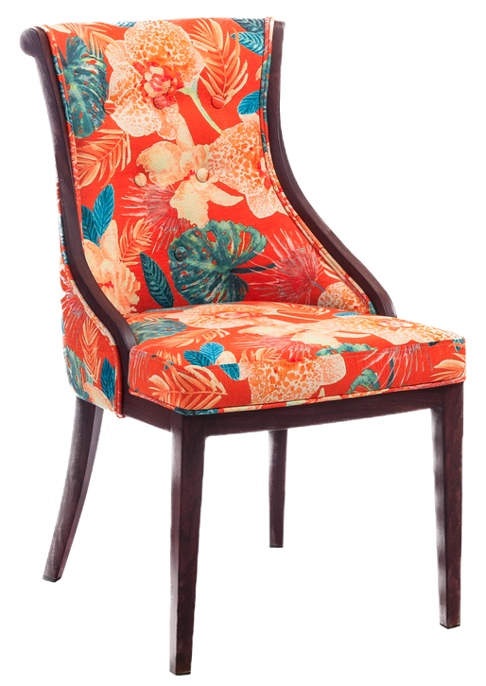
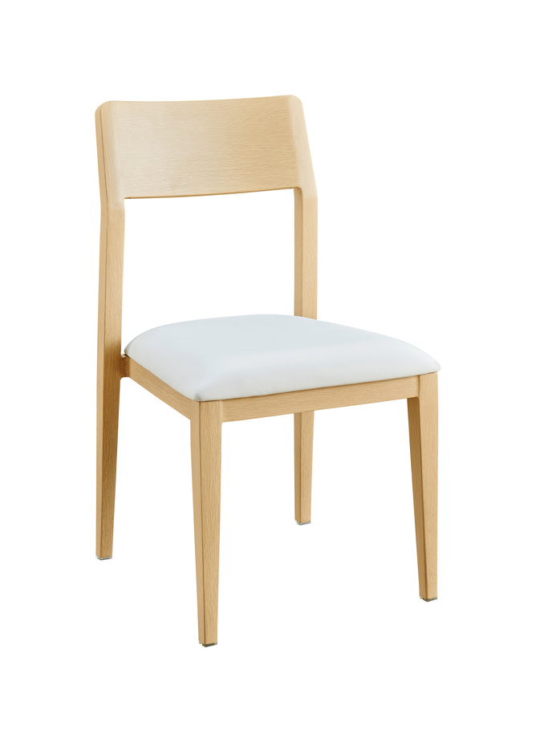
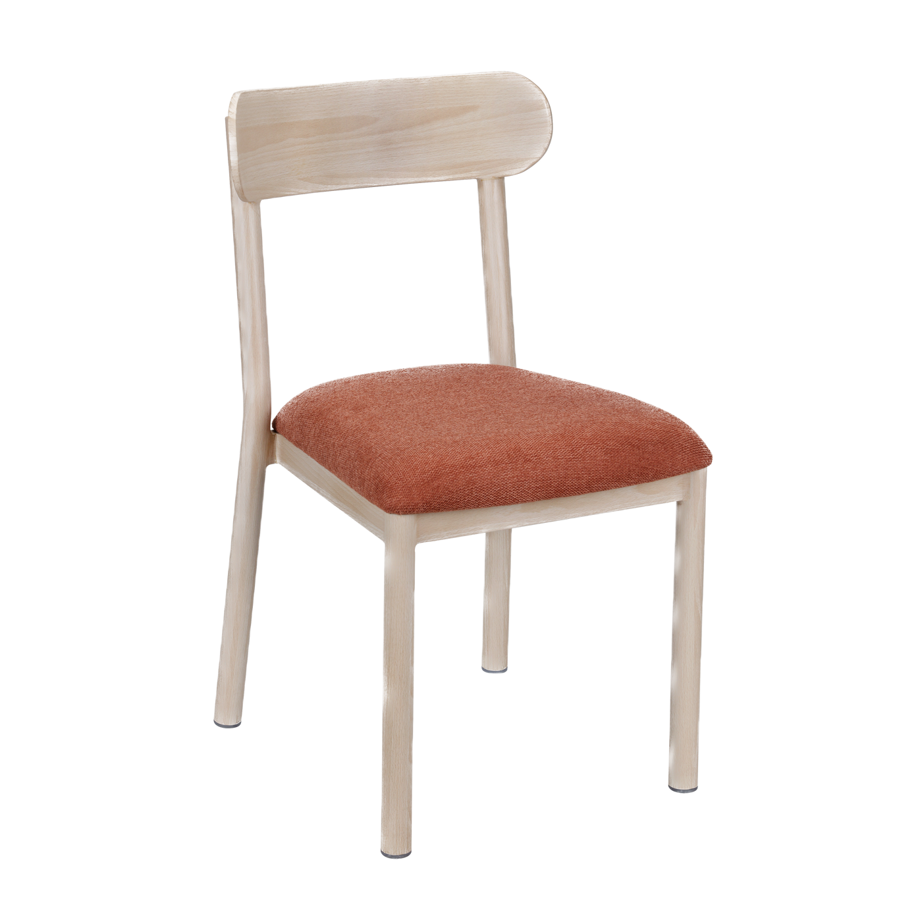
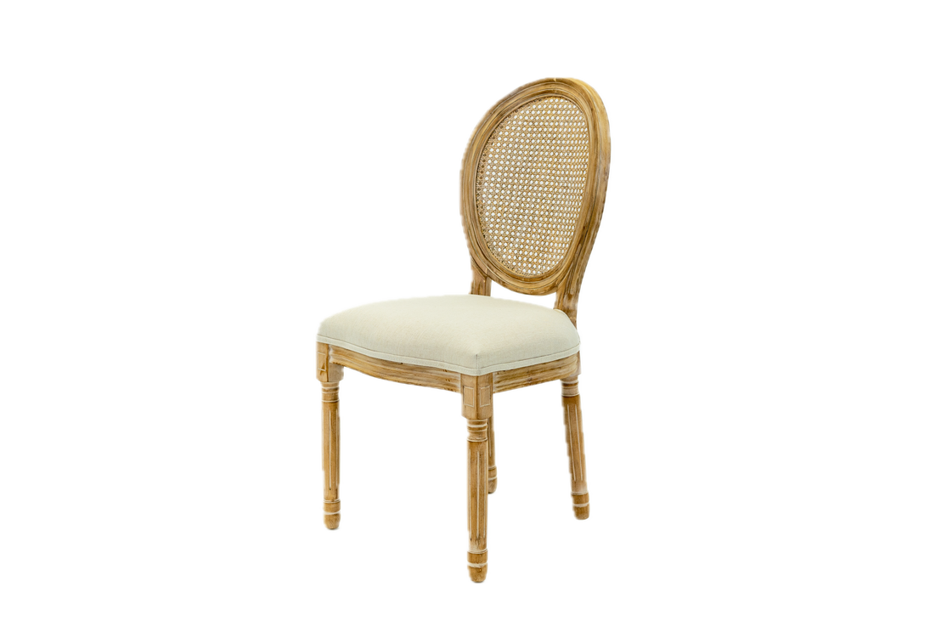
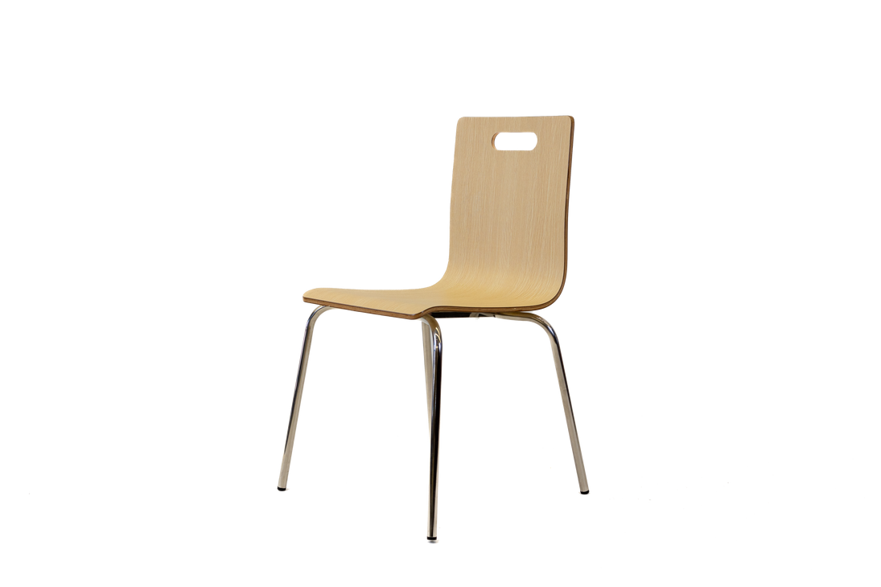
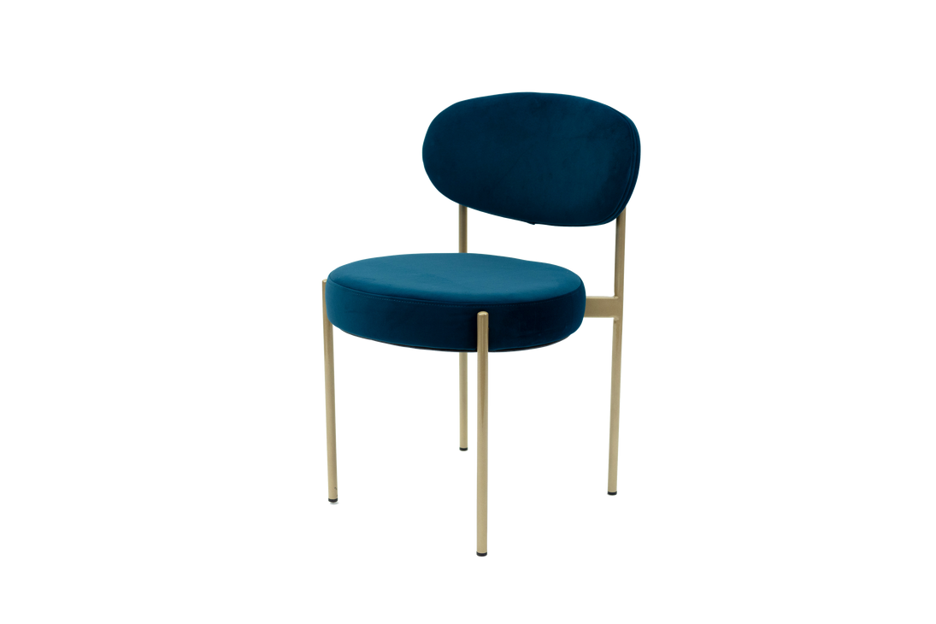
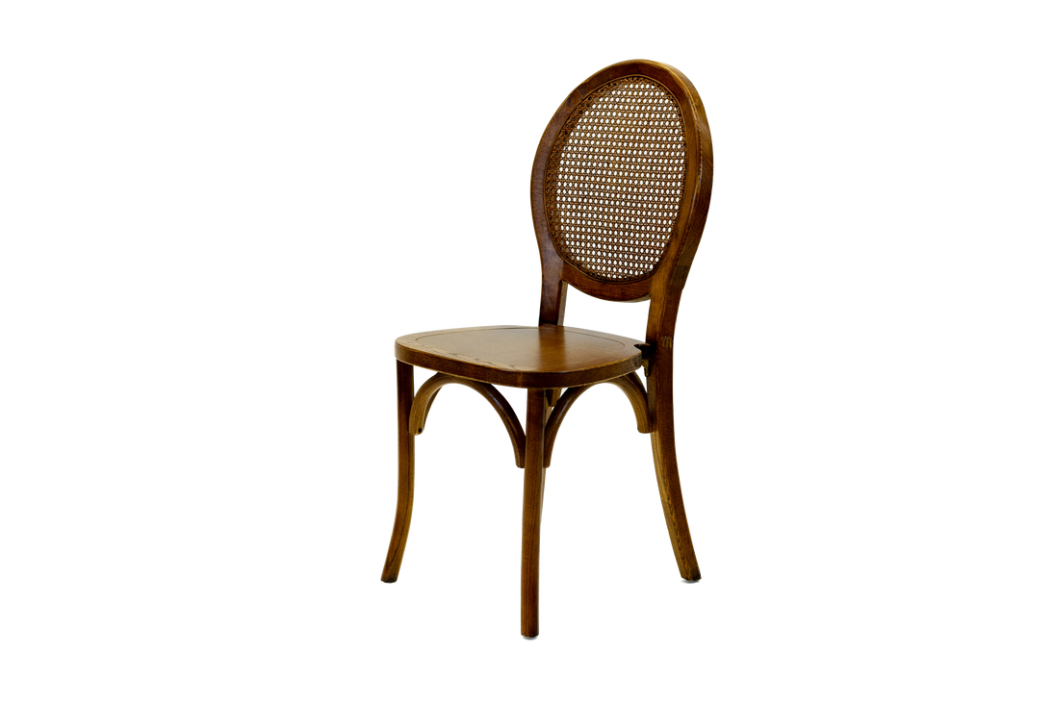
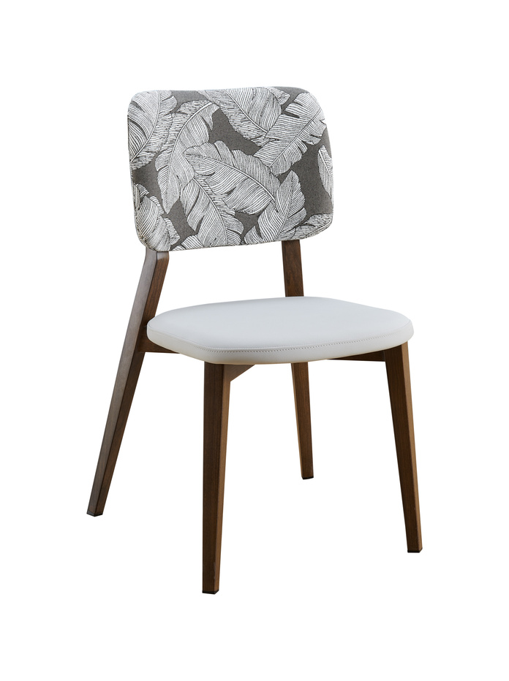
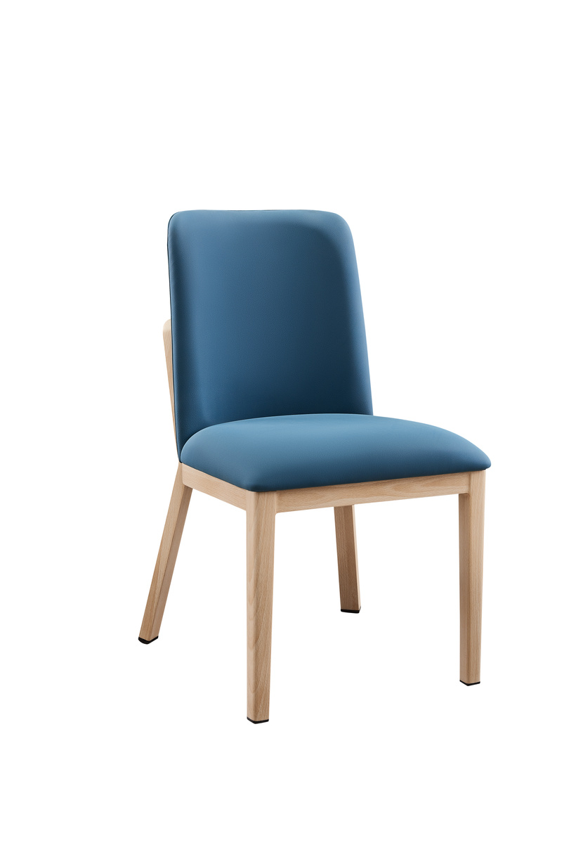
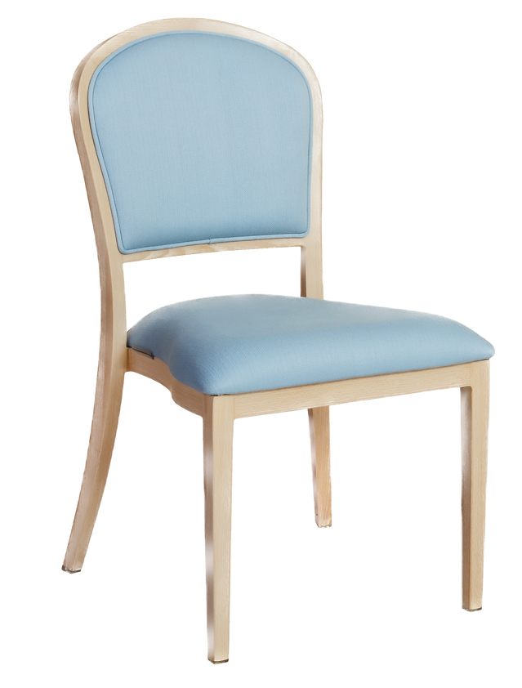
Our Products: Cafe Chairs*
*For more cafe chairs, please visit our website. For custom orders or more information please contact us at sales@auraseating.com

Slide 8
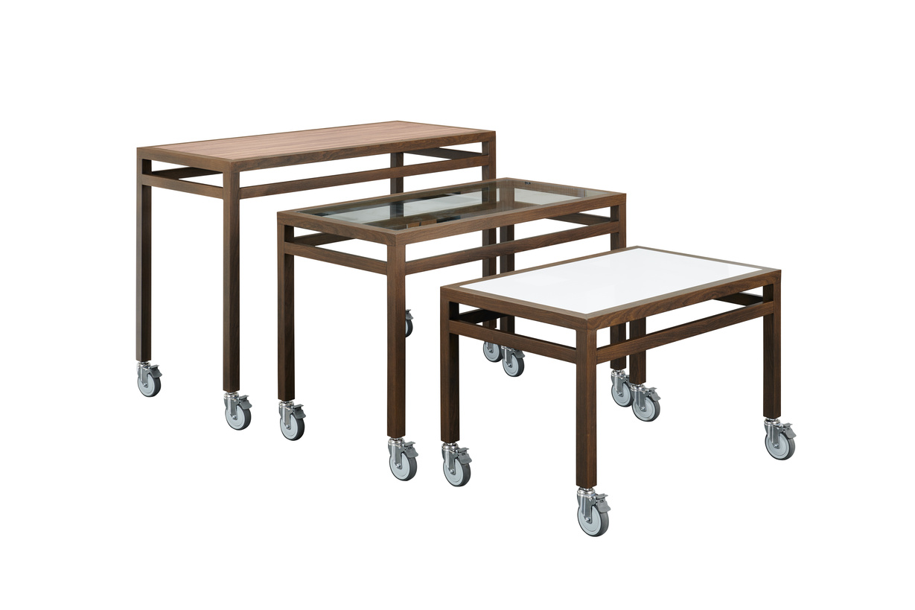
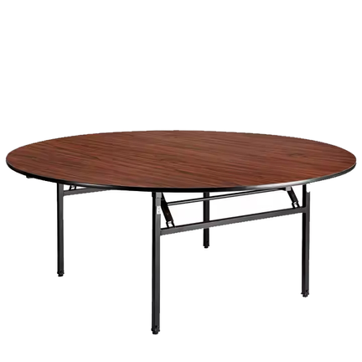
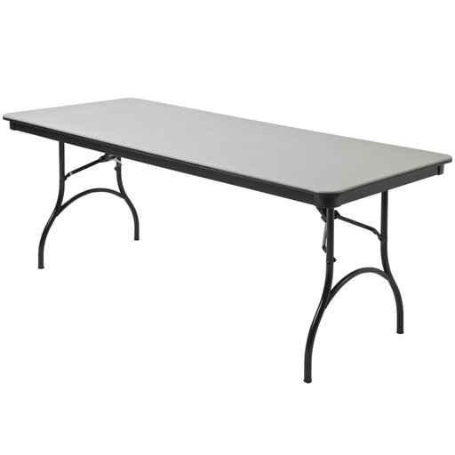
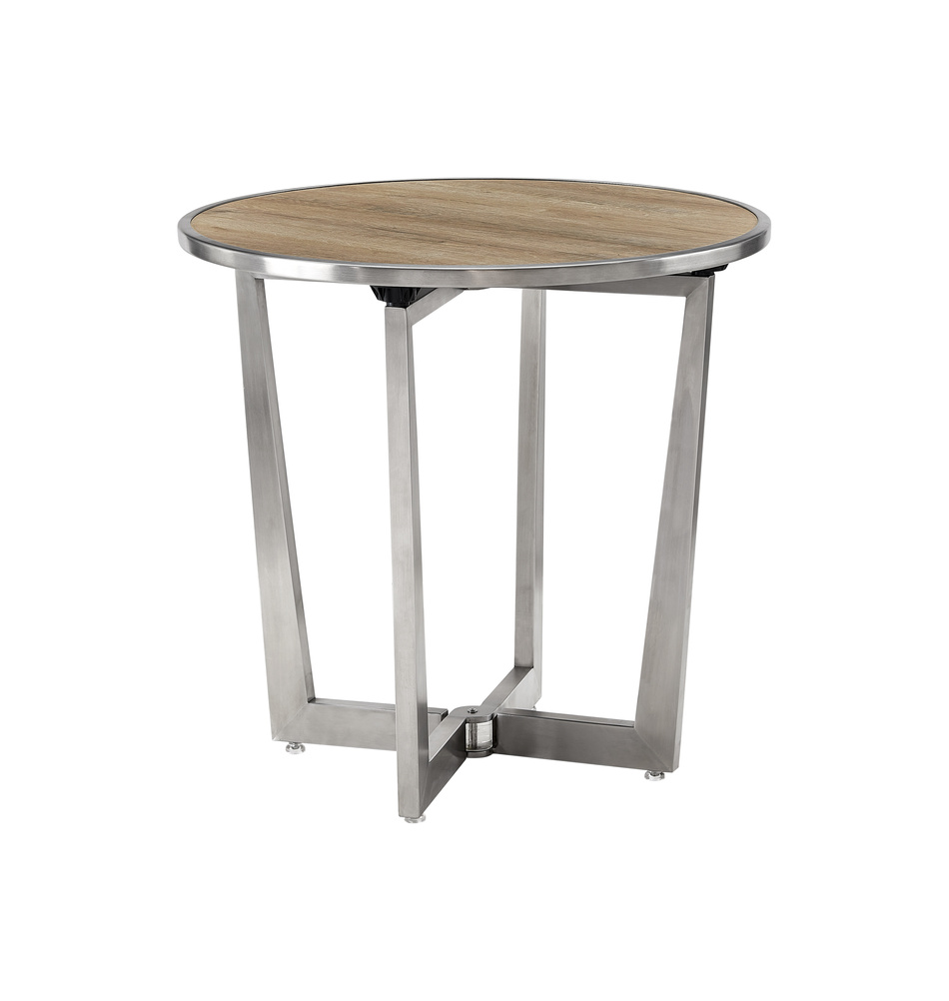
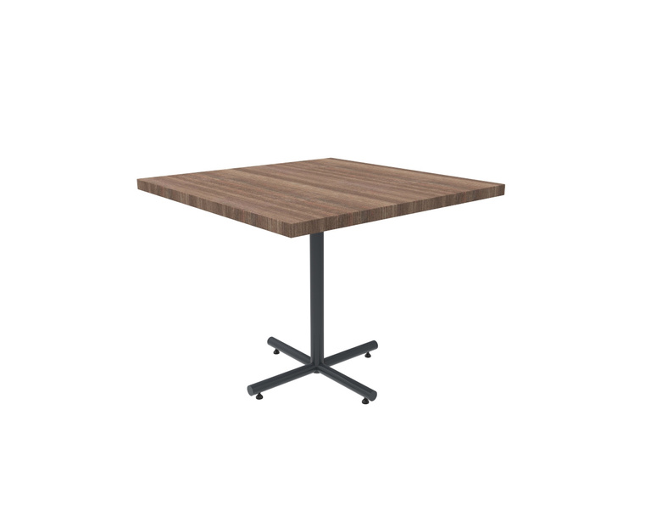
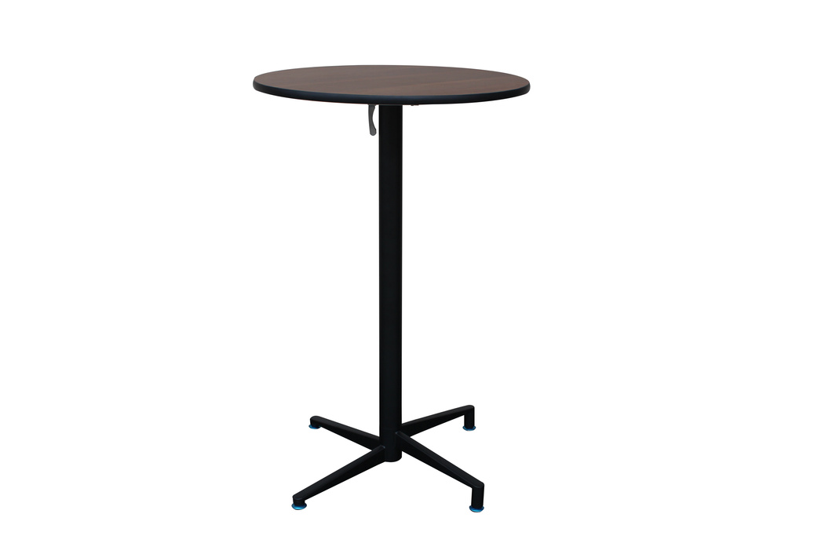
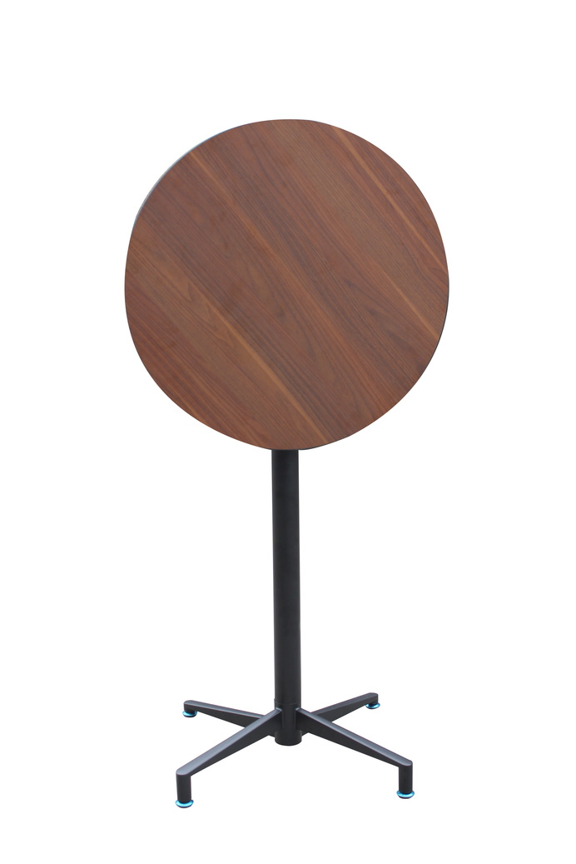
Our Products: Tables*
*For more tables, please visit our website. For custom orders or more information please contact us at sales@auraseating.com

Slide 9
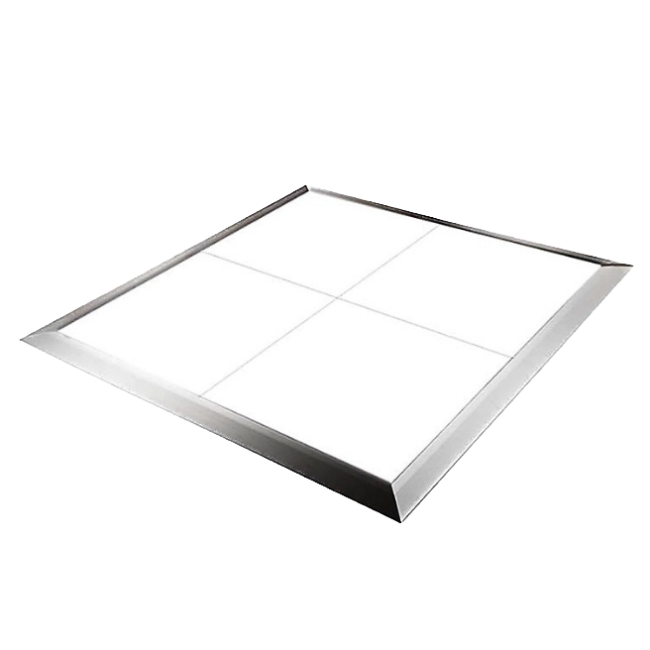
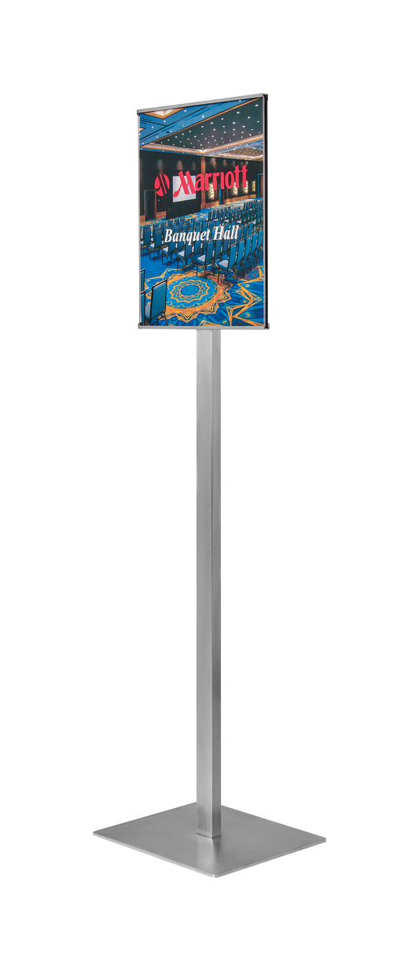
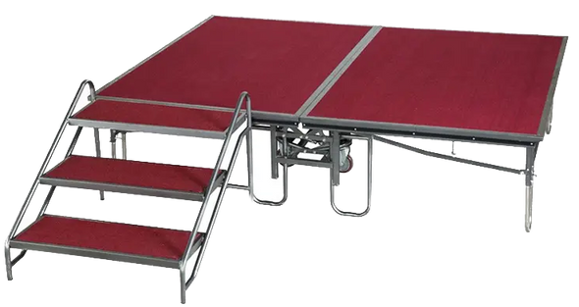
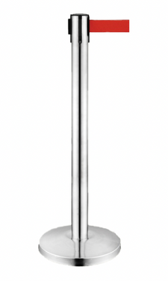
Our Products: Events*
*For more event products, please visit our website. For custom orders or more information please contact us at sales@auraseating.com

Slide 10
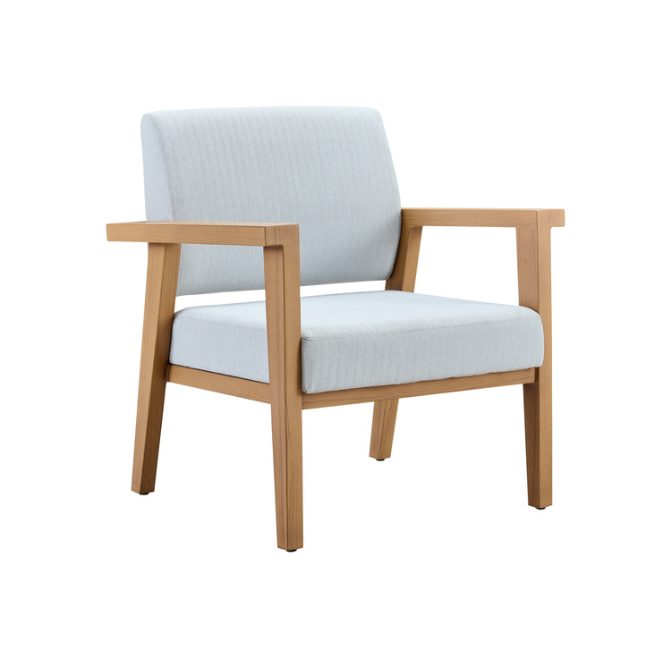
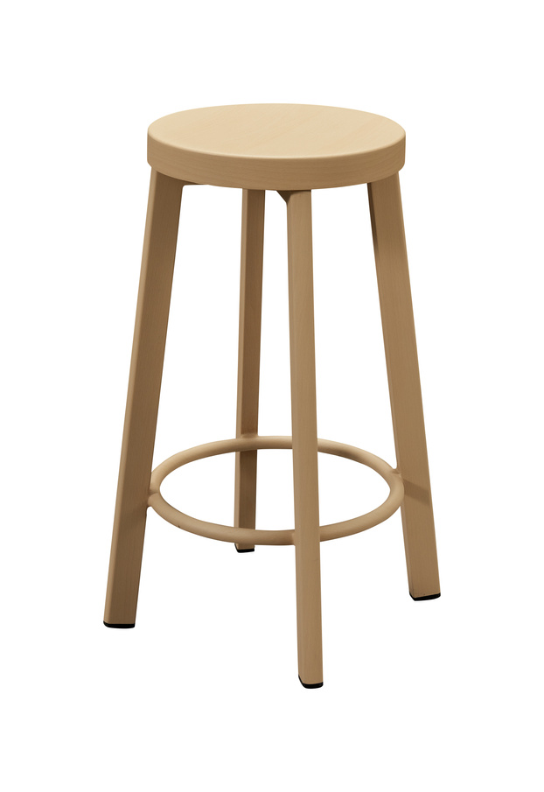
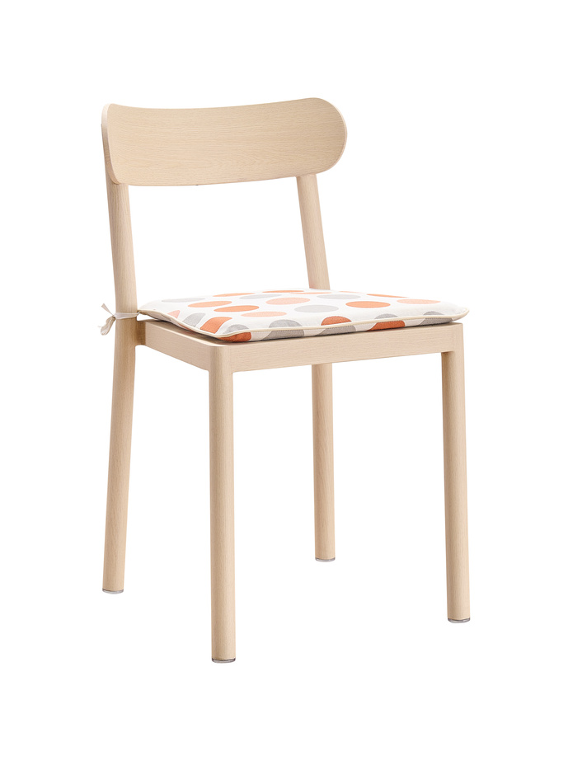
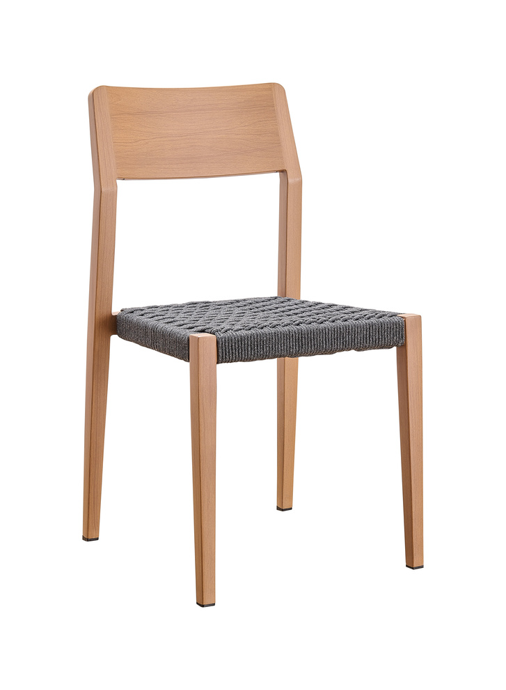
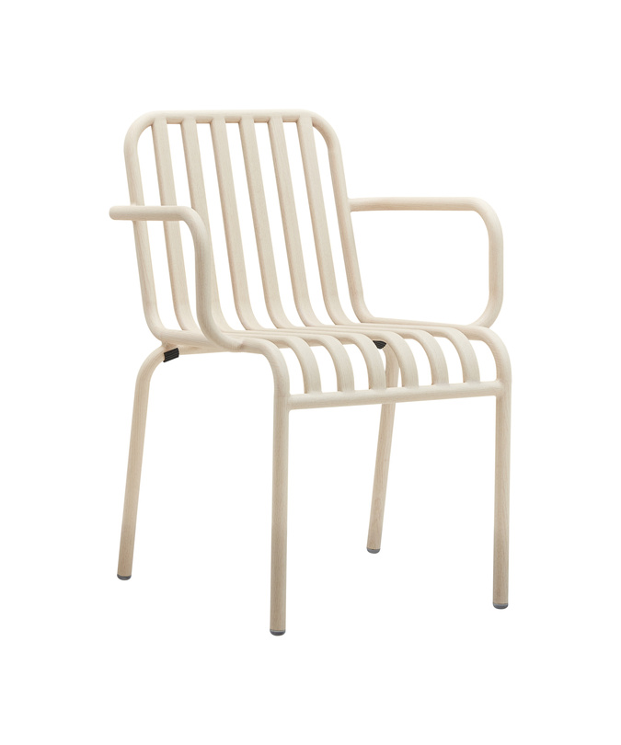
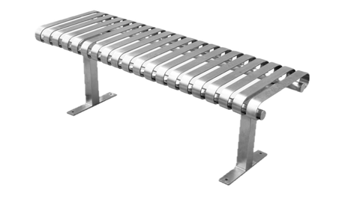
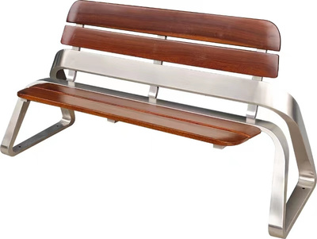
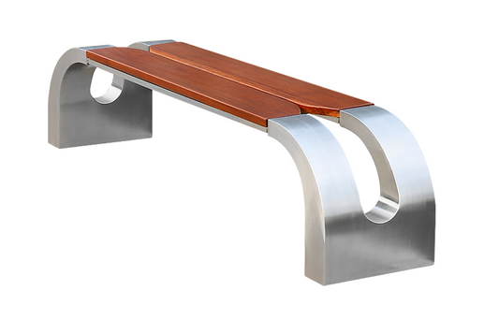
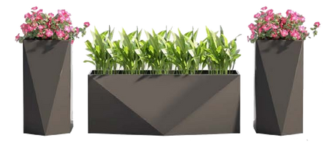
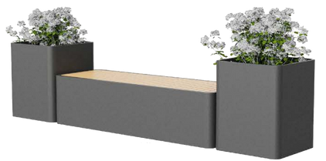
Our Products: Outdoor Furniture*
*For more outdoor furniture, please visit our website. For custom orders or more information please contact us at sales@auraseating.com

Slide 11
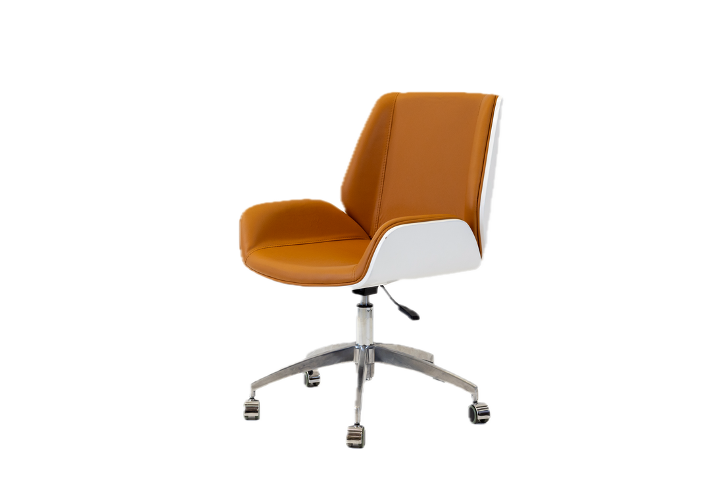
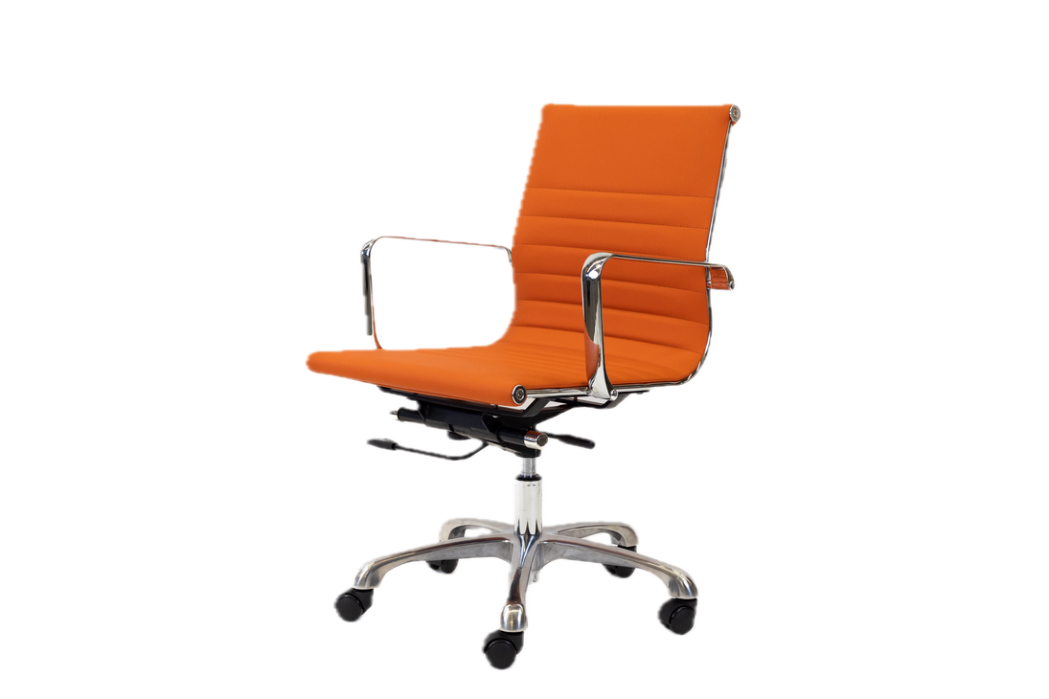
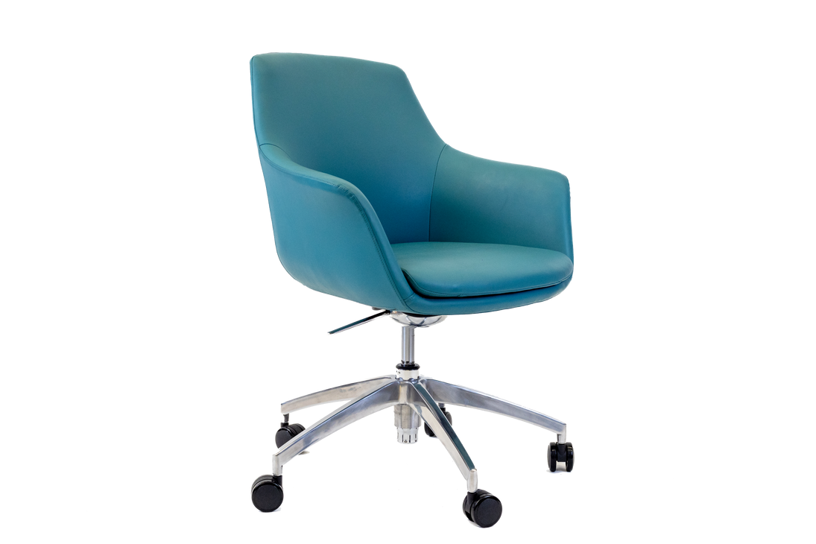
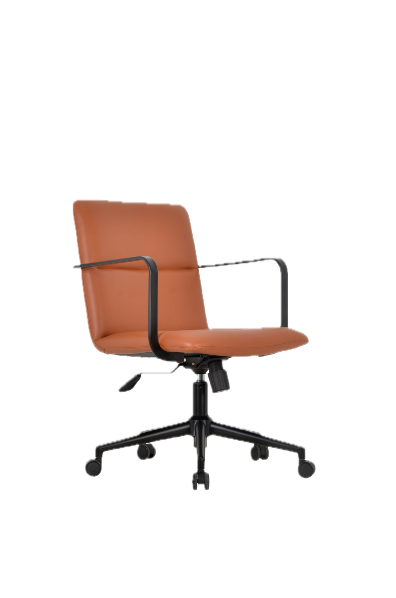
Our Products: Hotel Room Chairs*
*For more hotel room chairs, please visit our website. For custom orders or more information please contact us at sales@auraseating.com

Slide 12
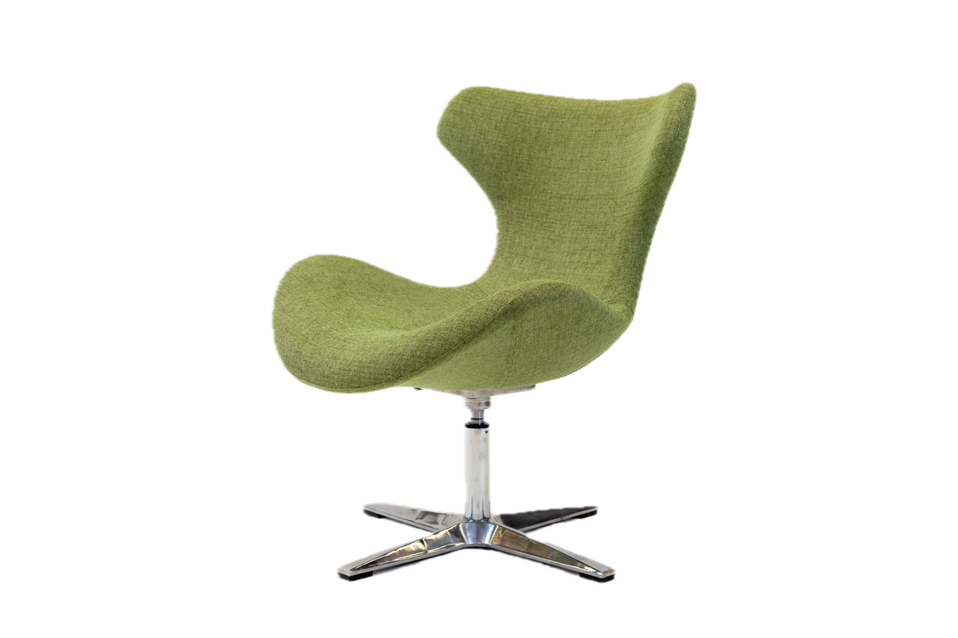
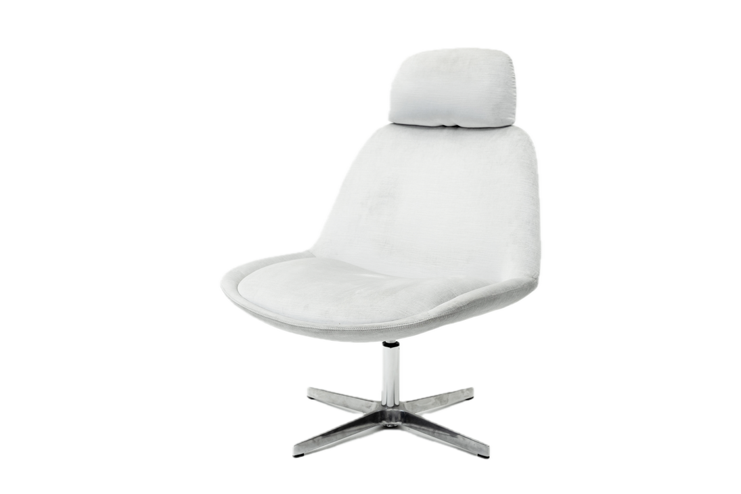







Our Products: Lounge*
*For more lounge products, please visit our website. For custom orders or more information please contact us at sales@auraseating.com

Slide 13










Our Products: Trash Cans*
*For more trash cans, please visit our website. For custom orders or more information please contact us at sales@auraseating.com

Slide 14


Please contact us for more information and custom products. We look forward to hearing from you!
Mahalo!
From the Aura Seating Team
Email: sales@auraseating.com
Phone: 310-373-0129
Website: auraseating.com
Address: 22353 Western Ave Ste 202 Torrance, CA 90501
Kanoa

